Slide 1
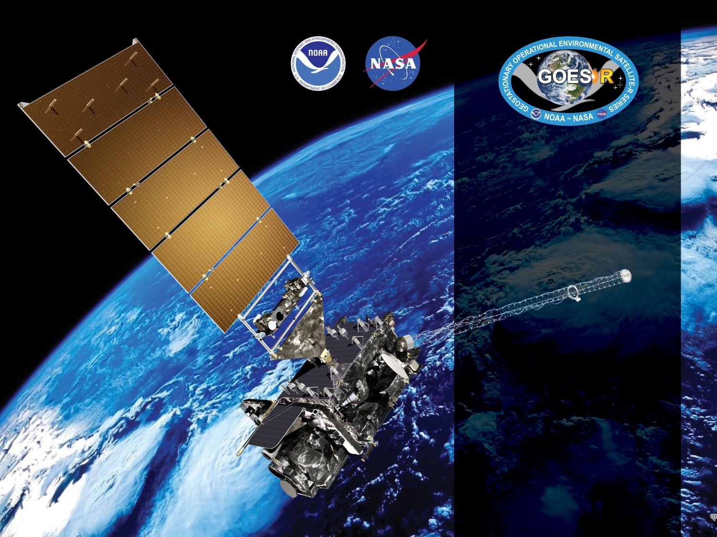
GOES-17 ABI L2+ Land Surface Temperature
Provisional PS-PVR
June 13th, 2019
GOES-R AWG
Yunyue Yu*,
Peng Yu⁺, Heshun Wang⁺
NOAA/NESDIS/STAR*
ESSIC/CICS-MD, UMD⁺

Slide 2
Outline
Product Overview
Product Quality Evaluation
Provisional Maturity Assessment
Path to Delta Maturity
Summary and Recommendations

Slide 3
PRODUCT OVERVIEW
GOES-17 Land Surface Temperature L2 Product Provisional PS-PVR

Slide 4
LST Product Background
LST is the instantaneous temperature of the earth “skin”
Emissivity-explicit split-window regression algorithm is used for GOES-17 LST EDR generation
GOES-17 LST EDR consists of three products: Full Disk (FD), CONUS, and Meso-scale (MESO1 and MESO2)
Users request
  EMC User’s request for verification of weather forecasting model output
  one of the Essential Climate Variables (ECVs) by the GCOS of the WMO
  General users for long-term global LST monitoring, agriculture monitoring, drought prediction, ecosystem monitoring, and climate studies, etc.
Notes:
Current algorithm does not use the term of the emissivity difference between band 14 and 15. Our efforts have been focused on the enterprise algorithm.
Application examples
Downscaling of GOES-16 LST over urban or non-urban areas and its application in weather prediction models.
Air surface temperature, heat index.
Application in drought, downscaling soil moisture product.

Slide 5
Mission Requirement
Products | LST (Skin): CONUS | LST (Skin): Full Disk | LST (Skin): Mesoscale
Geographic Coverage | CONUS | Full Disk | Mesoscale
Horizontal Resolution | 2km | 10km | 2km
Mapping Accuracy | 1km | 5km | 1km
Measurement Range (K) | 213 – 330 | 213 – 330 | 213 – 330
Measurement Accuracy¹ (K) | 2.5 | 2.5 | 2.5
Measurement Precision (K) | 2.3 | 2.3 | 2.3
Refresh Rate | 60 minutes | 60 minutes | 60 minutes
Vendor Allocated Ground latency | 3236 seconds | 806 seconds | 159 seconds
Extent Qualifier | Local Zenith Angle < 70 | Local Zenith Angle < 70 | Local Zenith Angle < 70
¹ The measurement accuracy 2.5 K is conditional with 1) known emissivity, 2) known atmospheric correction, and 3) 80% channel correction; 5K otherwise.
Notes:
The Full Disk LST resolution is 10 km. This has a few drawbacks:
10 km resolution limits its application (e.g., drought)
LST has large variability in space, such a coarse resolution is not enough for many studies;
This requires extra processing step of aggregation;
Aggregation algorithm is not available to AWG LST team, we can not reproduce the Full Disk product locally and therefore some issues can not be easily verified;
10 km is much larger than the footprint of in-situ stations (~ a few tens meters), leading to a large validation uncertainty.
All three products are hourly, which can not reflect the quick change of LST and fails to take advantage of the rapid scan by ABI, e.g., 10 (15) min for FD, 5 min for CONUS, and 1 min for two MESOs for mode 3 (6).

Slide 6
LST processing flow (AER)
LST retrieved if
  good pixel availability
        input data not out of space
        input data not bad data
        input data not missing
  not over ocean
  clear or probably clear
    not probably cloudy
    not cloudy

Slide 7
Product quality evaluation
GOES-17 Land Surface Temperature L2 Product Provisional PS-PVR

Slide 8
Top Level Summary of
Product Quality
The analysis was based on the product during the “cool” period with relatively low and stable focal plane module (FPM) temperature
The LST product quality is satisfactory
  Overall performance compared to in-situ observations is good
  Significant improvement of the underestimate at Desert Rock site if TPW issue is fixed.
LST Product at low and stable focal plane module (FPM) temperature period is ready for operational use and for use in comprehensive cal/val activities and product optimization.

Slide 9
PLPTs Under Review: Provisional
Test ID | Test Title
ABI-FD_LST09 | FD product accuracy and precision assessment
ABI-CONUS_LST10 | CONUS product accuracy and precision assessment
ABI-MESO_LST11 | MESO product accuracy and precision assessment

Slide 10
Closed LST ADRs
Title | Description | Status | Mitigation
ADR 547 | Incorrect use of TPW in LST retrieval | Closed | Installed in OE on 1/18
ADR 340 | Incorrect metadata calculation | Closed | Installed in OE on 4/18
ADR 340 | LST retrieval available under cloudy or probably cloudy conditions | Closed | Installed in OE on 4/18
ADR 644 | Bits-swap of two-bits flags in LST PQI | Closed | Installed in OE on 7/18
ADR 644 | Incorrect “valid_range” | Closed | Installed in OE on 7/18
ADR 358 | Backup inputs not utilized when primary is missing | Closed | Installed in OE on 10/18
ADR 870 | LST does not check pixel-level validity of ABI TPW | Closed | Installed in OE on 3/19
ADR 907 | M6 LST generation schedule | Closed | Resolved without action (since 05/08/2019)
Notes:
Items 2 and 3 combined in the same ADR 340
Item 5 was added to ADR 644 in the last minute.

Slide 11
Open/Pending LST ADRs
Title | Description | Status | Mitigation
ADR 761 | LST Data Type | Submitted to ClearQuest | No impact on maturity status
ADR 970 | Incorrect Units used in LST TPW Ingest | In analysis | LST is being re-processed in local environment
ADR 899 | Optimize TPW usage
Notes:
Unsigned-integer data type leads to much confusion among different software packages, it is proposed to change the data type to signed integer and only use the positive half for LST. Advantages: 1. Consistent to its current implementation, 2. No confusion. Disadvantage: scaling error doubles, negligible impact on product performance.

Slide 12
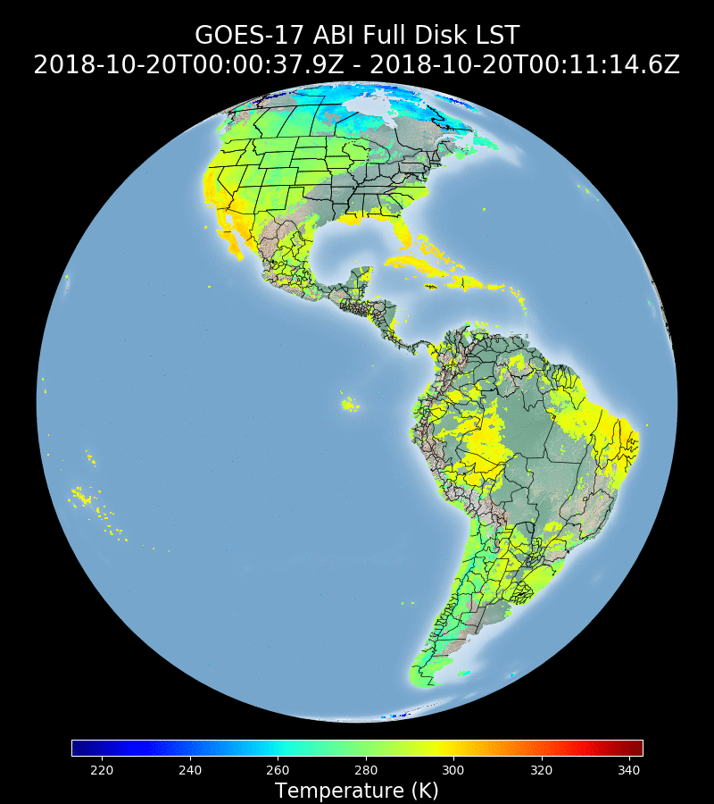
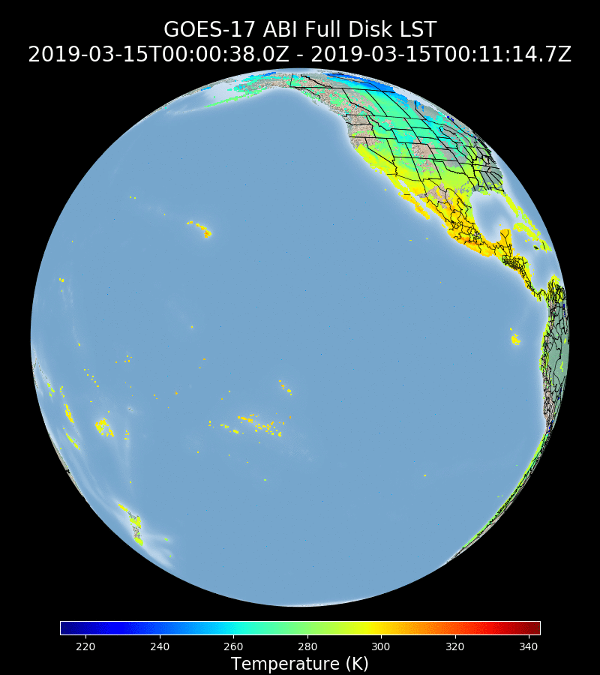
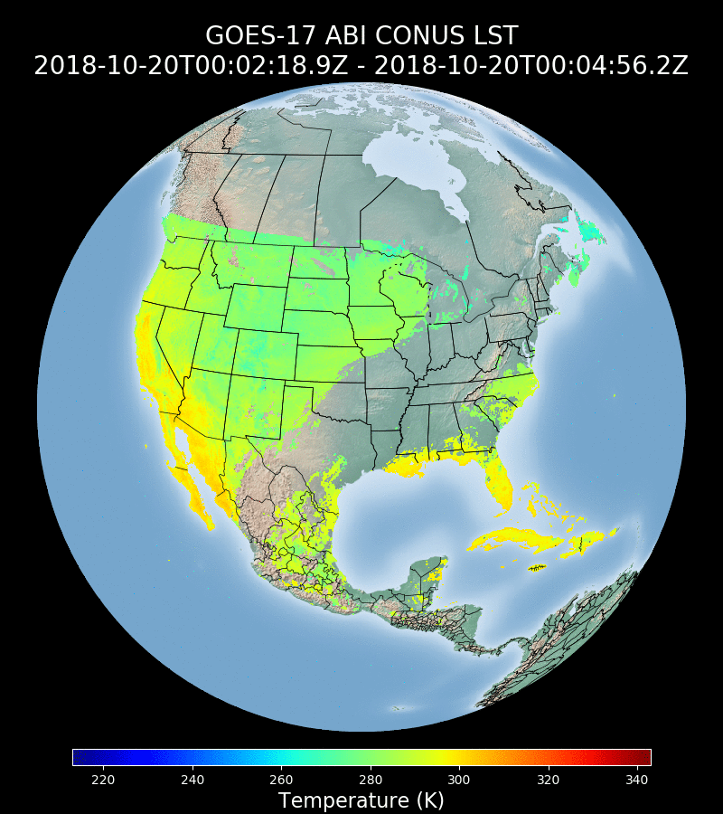
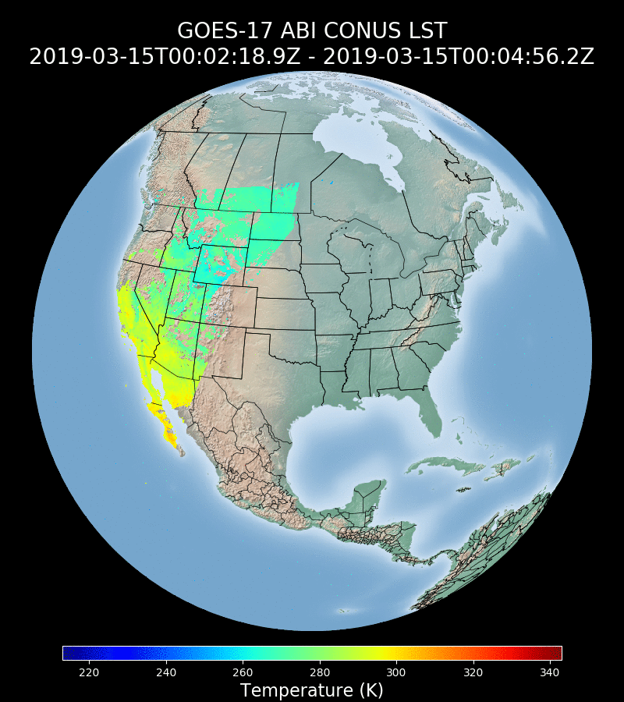
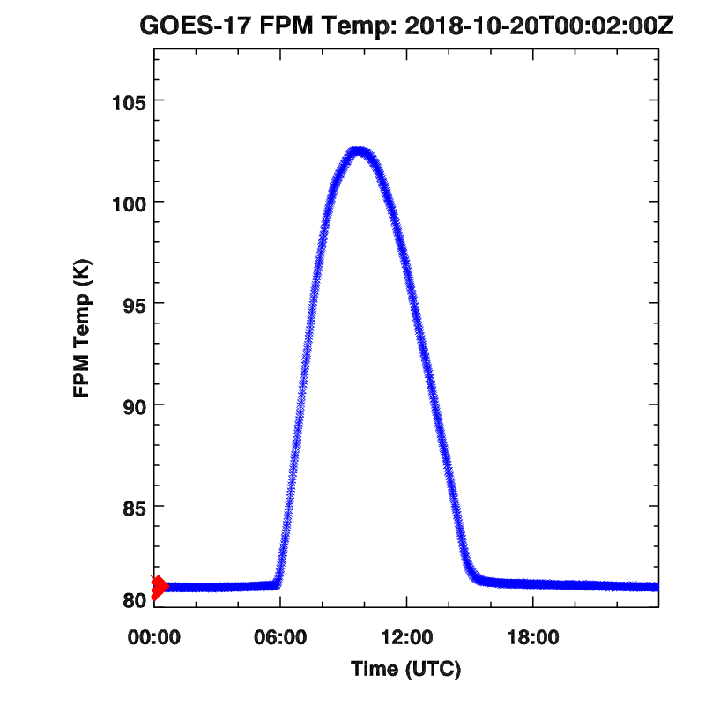
Visual Inspection
GOES-TEST
2018-10-15
GOES-WEST
2019-03-15
G17 FPM Temp
2018-10-15
Notes:
Left: FD and CONUS LSTs at GOES-Test. An example impacted by high FPM temperature (Middle: maximum at around 103 K).
Anomaly, saturation (missing data), striping can be observed between Hours 9 and 15.
Right: FD and CONUS LSTs at GOES-West. Relatively low FPM temperature period, minimally impacted by the FPM temp.

Slide 13
Product Inspection
Quality Flag
Bit | Error Code
 | 01 | 02 | 03 | 04 | 11 | 12 | 13 | 14
1 | ✓ | ✓ | ✓ | ✓ | ✓
2 | ✓ | ✓ | ✓ | ✓ | ✓
3 | ✓ | ✓ | ✓ | ✓ | ✓
4 | ✓ | ✓ | ✓ | ✓ | ✓ | ✓ | ✓ | ✓
Product Metadata
Products | Min | Max | Mean | Std | Good | Retrieved | outlier
CONUS M3 | ✓ | ✓ | ✓ | ✓ | ✓ | ✓ | ✓
CONUS M4 | ✗ | ✗ | ✗ | ✗ | ✗ | ✗ | ✗
DQF Metadata
Prod | 10* | 11 | 20 | 21 | 30 | 31 | 40 | 41 | 50 | 51 | Good
CONUS M3 | ✓ | ✓ | ✓ | ✓ | ✓ | ✓ | ✓ | ✓ | ✓ | ✓ | ✓
CONUS M4 | ✗ | ✗ | ✗ | ✗ | ✗ | ✗ | ✗ | ✗ | ✗ | ✗ | ✗
Passed
Correction in process
Not passed
* xy: x denotes the xth bit of DQF, and y is its value.
✓
x
✗
Inspection based on CONUS LST during March 2019
Notes:
CONUS LST during March 2019 is used for this inspection.
FD LST involves aggregation, which is not available to LST AWG. So we focus on the testing of CONUS LST for this purpose.
CONUS M4 metadata is based on blocks, some of which might consists of areas out of CONUS. This leads to the inconsistency between the metadata calculated locally and those included in the official product.

Slide 14
Product Validation

Slide 15
Definitions of Metrics for Quantitative Comparisons
Passed: Accuracy and Precision meet or slightly exceed requirements. Potential contributors for deviations are identified.
Partial-Passed: Accuracy/Precision deviates significantly from requirements, but potential contributors for deviations are identified.
Failed: Accuracy/Precision deviates significantly from requirements and source of poor performance is unknown, or source known and correction requires new algorithm.

Slide 16
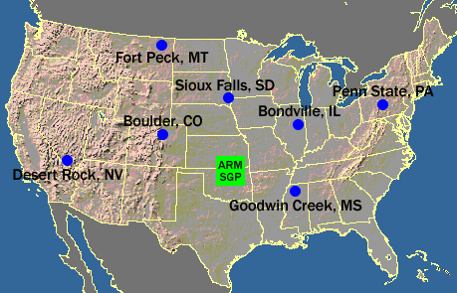

In-situ ground observation data
SURFRAD Sites
  Surface Radiation Budget Network (SURFRAD) – 7 operational sites in CONUS
    Radiometer measuring broadband radiation every minute
    Available within a day or two of observation
    Instrument calibrated annually and well maintained
    $LST=\frac{F↑−\left(1−ε\right)F↓}{εσ}$
  We need data outside US, in Central and South America
Notes:
16
High-quality in-situ validation site for LST is very limited, especially after GOES-17 becomes GOES-West.
More sites are needed.
16

Slide 17
Incorrect Units used in LST TPW Ingest
ADR 547:
  to address the incorrect units used in LST TPW ingest.
  Verified from both DE and OE
  Installed Jan. 2018
ADR 358 (PR 07.00.02):
  to address “Backup inputs not utilized when primary is missing”
  Significant difference was found during the inspection of ADR 358 included in PR 07.00.02.
  The ADR was installed on Oct. 15, 2018 regardless.
ADR 970:
  Further analysis suggested that TPW unit in LST retrieval is likely incorrect.
  LST retrieval was stratified by different TPW levels.
  The unit of TPW used in LST retrieval shall be cm based on ATBD and ADD
  The TPW used for LST retrieval in Ground System is likely in mm, so that incorrect coefficient might be used.
  Degradation of the product.
  ADR 358 not based on ADR 547?
Notes:
ADR 358 (for LST & AOD): Backup inputs not utilized when primary missing.
Though LST AWG’s analysis is very convincing, it is not a sure proof since the local environment from the team can not exactly mimic the LST module in ground system.
LST retrieval uses TPW to determines the correct coefficient set to be used for any specific pixel. Incorrect TPW values lead to incorrect coefficient set used in LST retrieval and potential degradation of the product. The latter is actually seen from the validation results based on LST from ground system and local calculation with correct TPW unit as in the following slides.
Other TPW related ADRs:
ADR 870: LST does not check pixel-level validity of ABI TPW
ADR 899: Optimize TPW usage (current scene ABI TPW)

Slide 18
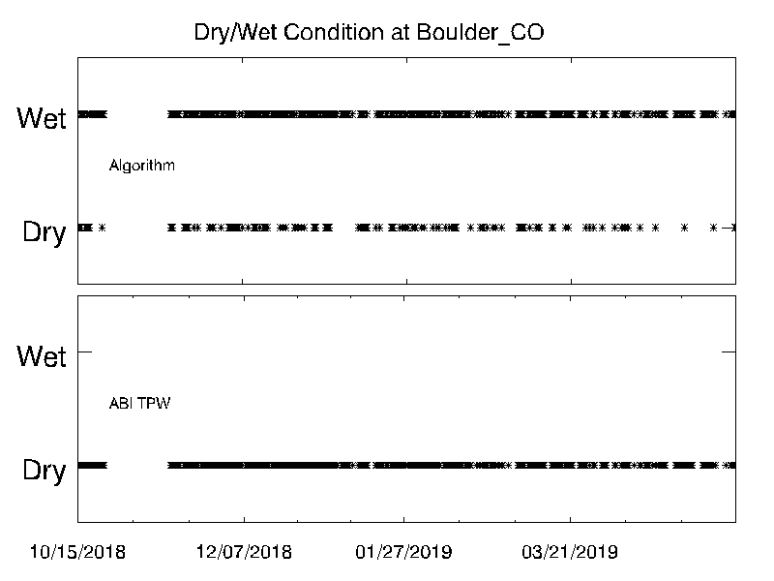
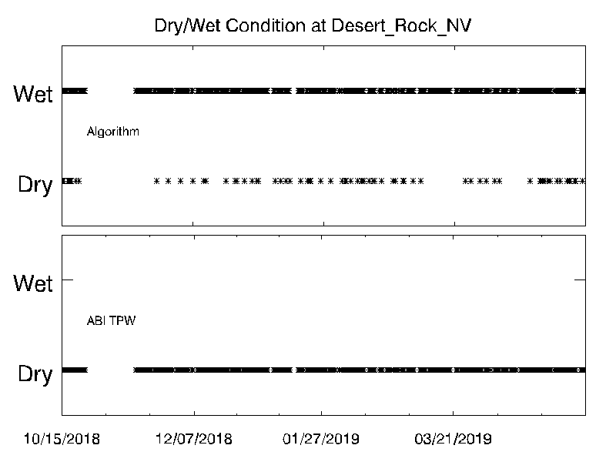
TPW Issue in LST Retrieval
Analysis was done at two relatively dry SURFRAD sites.
Time series starts from 10/26/2018 till recent (dry season)
Upper panels show the dry/wet conditions (separated by 2cm) used in Ground System, by reversing the retrieval.
Lower panels show the dry/wet conditions suggested by matched ABI TPW.
The two are significantly inconsistent
Notes:
The results shown are for two dry sites during dry season, it is expected that dry condition is dominant.
Lower panels: dry/wet conditions by reversing the algorithm
Upper panels: dry/wet conditions suggested by ABI TPW with correct unit (cm)
Similar results were obtained from the other five SURFRAD sites.

Slide 19
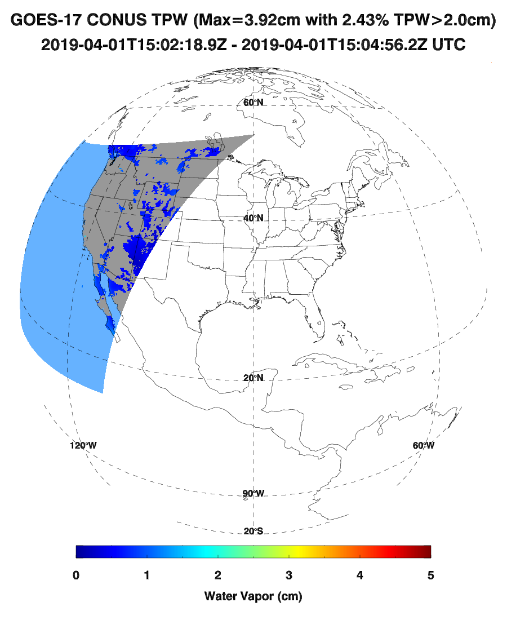
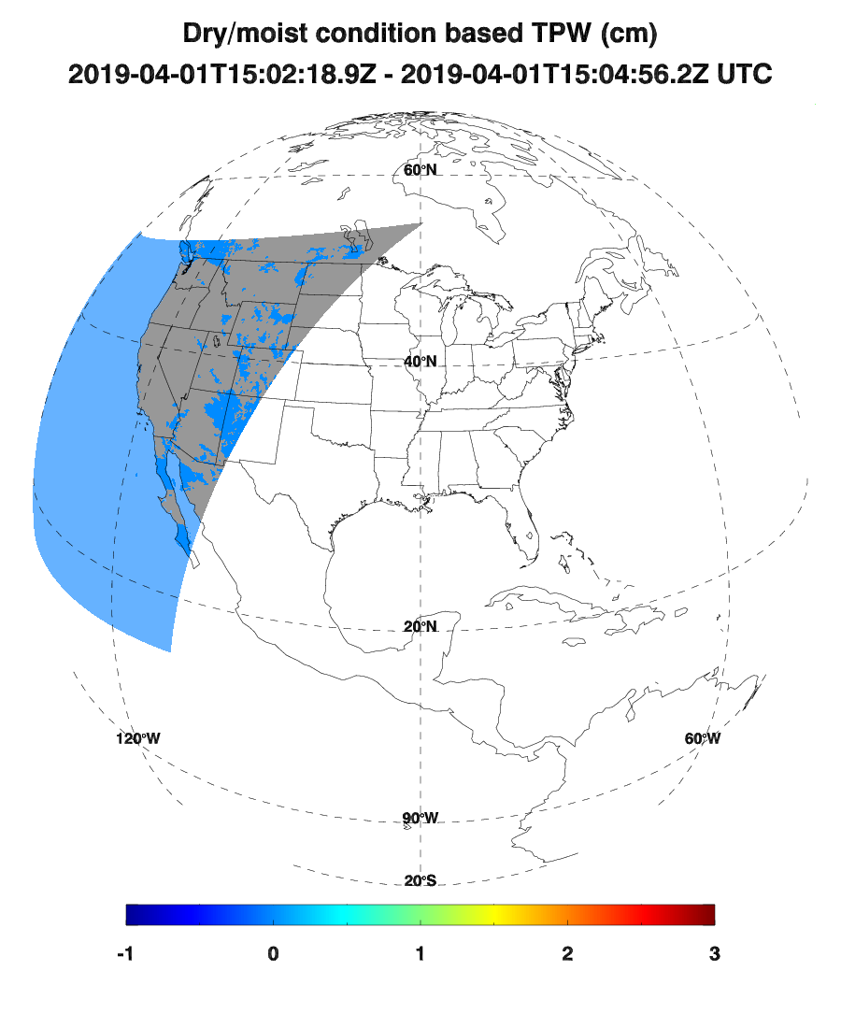
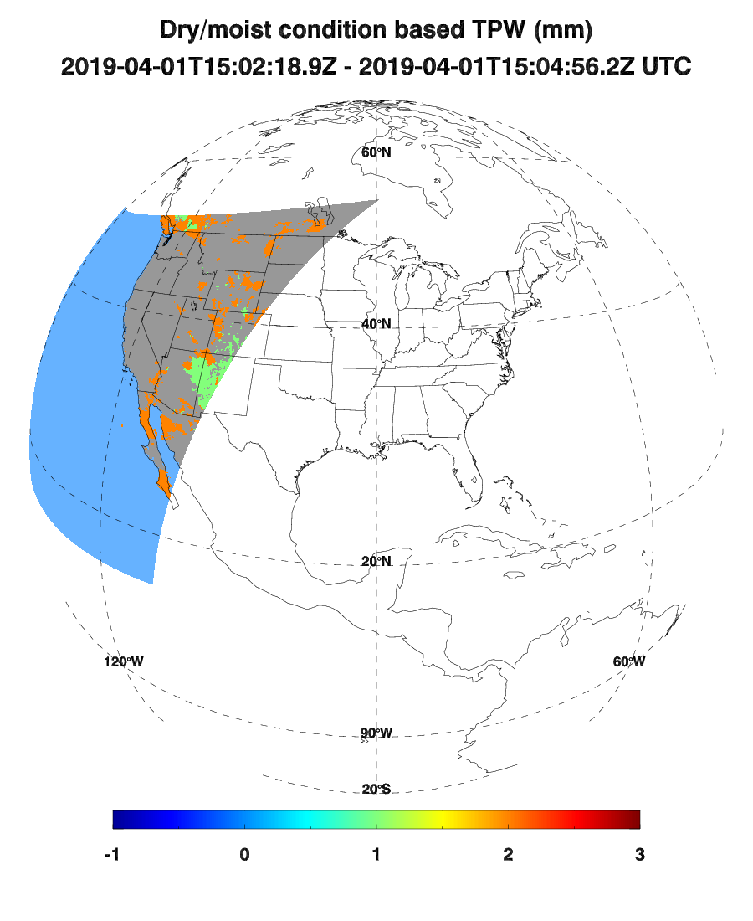
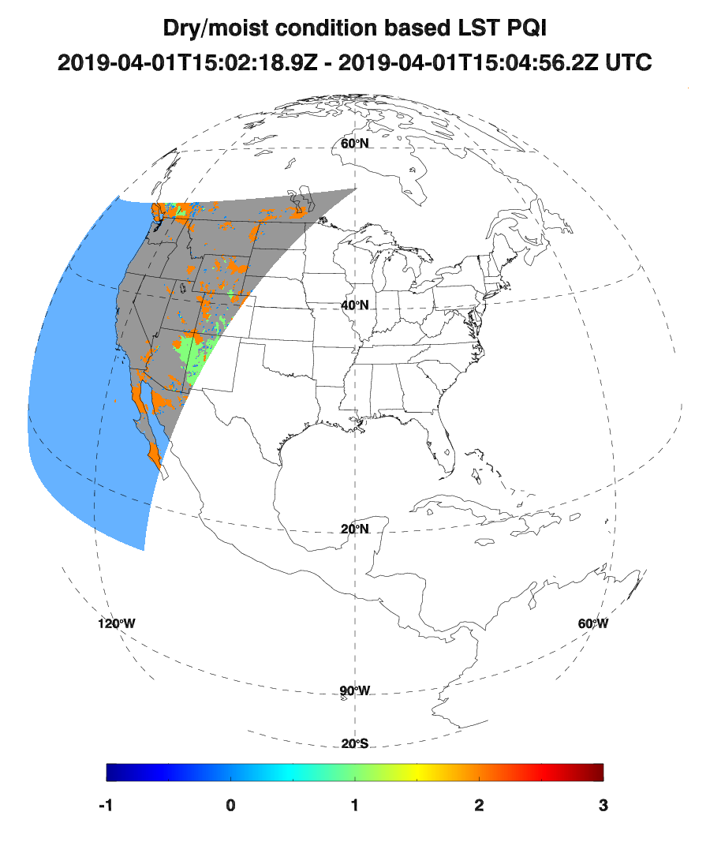
TPW Issue in LST Retrieval
Top : TPW in cm. It suggested that the scene is very dry with only 2.43% wet pixels (>2cm). ( The maximum is 3.92 cm)
Bottom left: Dry/wet condition based on TPW in correct unit (cm), significantly different from that used in GS.
Bottom middle: Dry/wet condition based on TPW in incorrect unit (mm)
Bottom right: Dry/wet condition from LST IP PQI, which is consistent with top middle. This suggests the unit used in GS LST retrieval is in mm
Notes:
Top left: TPW in cm. The whole scene is very dry with only 2.43% wet pixels (>2cm).
Bottom left: Correct Dry/wet condition
Bottom center. Incorrect Dry/wet condition if TPW is in incorrect unit (mm)
Bottom right: Dry/wet condition from LST IP PQI, which is consistent with top center. This serves as a direct indication that the TPW used in GS LST retrieval is in mm

Slide 20
Reference Algorithm
The enterprise LST retrieval algorithm was used as a reference algorithm to compare with the baseline LST
Selected among 22 different algorithms
Target implementation schedule: 6/5/2020.
Different from the baseline algorithm
  Emissivity difference term is used
  Instead of a angle-correction term, the retrieval is stratified by sensor zenith angle
  Stratification by finer TPW ranges
Notes:
Enterprise algorithm will replace the baseline algorithm.
The implementation in GS is scheduled at June 2020.
The enterprise algorithm for JPSS has been implemented in NDE system and replaced the existing IDPS algorithm.

Slide 21
Validation Procedures
Direct comparison with SURFRAD in-situ measurements
Validate Data: 2018/07/19 – 2019/05/12
High FPM temperature periods removed (https://www.
goes-r.gov/users/GOES-17-ABI-Performance.html)
Cloud screening
  Intermediate Product unavailable for significant amount of validation period, i.e. four levels cloud information missing
  Based on 3x3 two-level cloud from DQF
Additional cloud filtering
  In-situ downwelling radiation time series
  Satellite 3x3 Brightness Temperature at ~11 µm (band 14)
Notes:
20180719: To make the time series long enough for validation purpose
The predicted “hot” periods in year 2019 listed in the table are removed for provisional activities. We extended the table to when the satellite is on Test position by decreasing the start and end time of each period with 3 hours.
Big impact on LST validation due to unavailable IP data (4-level cloud info missing). Additional cloud filtering
High FPM temperature periods were removed based on https://www.goes-r.gov/users/GOES-17-ABI-Performance.html. All validation results and related statements are made based on the product during the “cool” period

Slide 22
CONUS LST Validation
Site | Number | Ground System |  | Reprocessed |  | Enterprise
 |  | Accuracy | Precision | Accuracy | Precision | Accuracy | Precision
BND | 374 | -0.88 | 1.57 | -0.09 | 1.53 | 0.54 | 1.48
TBL | 782 | -1.86 | 1.52 | -1.13 | 1.44 | -0.69 | 1.38
DRA | 1148 | -4.91 | 1.86 | -3.71 | 2.11 | -2.48 | 2.13
FPK | 753 | -1.41 | 2.03 | -1.17 | 2.10 | -0.81 | 2.11
GWN | 473 | -0.82 | 2.58 | 0.19 | 2.61 | 1.03 | 2.42
PSU | 175 | -0.13 | 1.71 | 0.81 | 1.76 | 1.54 | 1.75
SXF | 473 | -0.90 | 1.68 | -0.41 | 1.59 | 0.30 | 1.42
Overall | 4178 | -2.23 | 1.81 | -1.44 | 1.89 | -0.69 | 1.87
Notes:
Validation results at most sites are good.
Significant underestimate at Desert Rock can be observed even though it is improved by fixing the TPW issue.
Precision requirement is marginally met at Goodwin Creek site.
Further analysis of these two sites will be given later.
Compared to LST from Ground System, the underestimate at desert rock site got improved in the reprocessed LST and enterprise LST.
The overall bias was significantly impacted by the underestimate at Desert Rock (more data pairs and high underestimate values)
Overall statistics suggests the mission requirement has been met.
In general, the enterprise algorithm is superior to baseline algorithm.
Even though TPW issue was not fixed during most of the time series of official LST product, its overall statistics meet the mission requirement

Slide 23
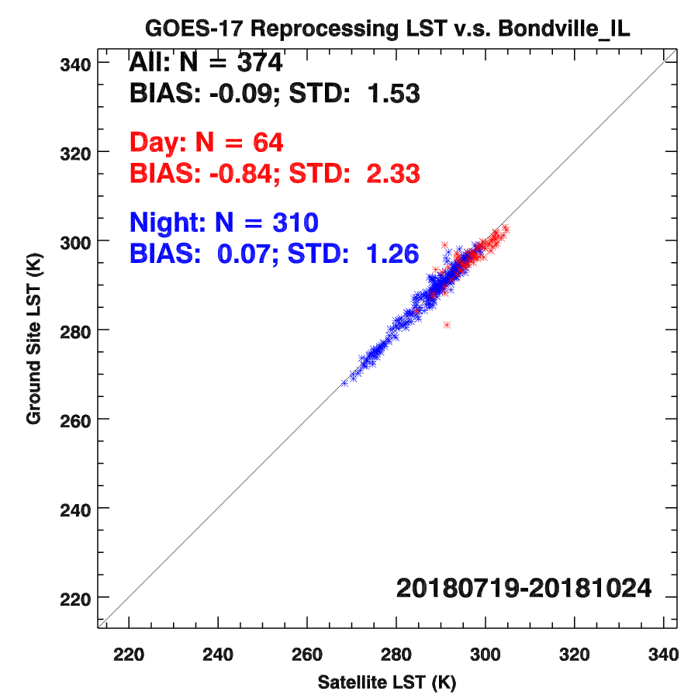
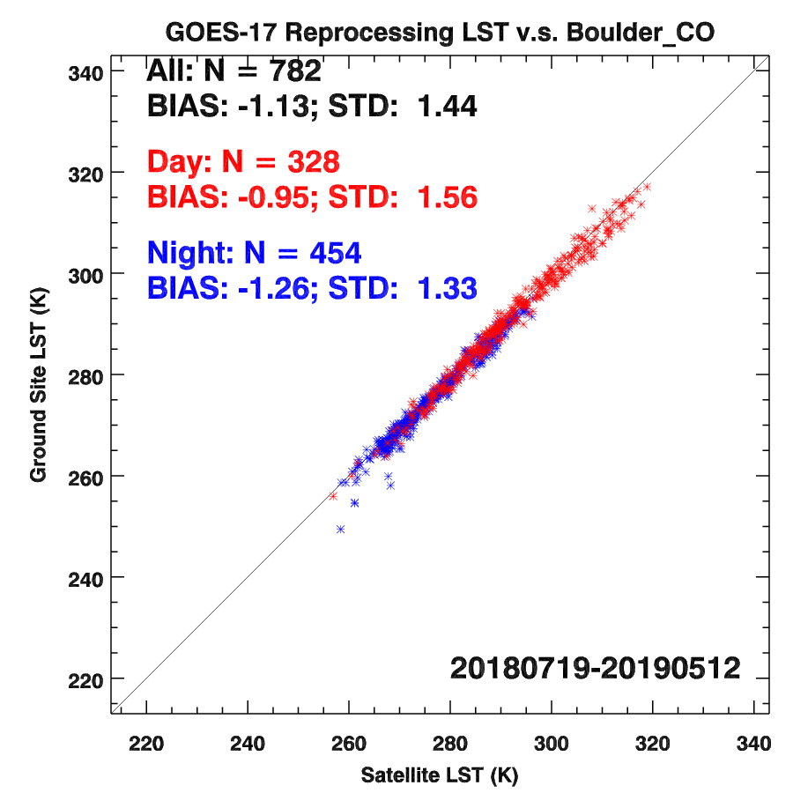
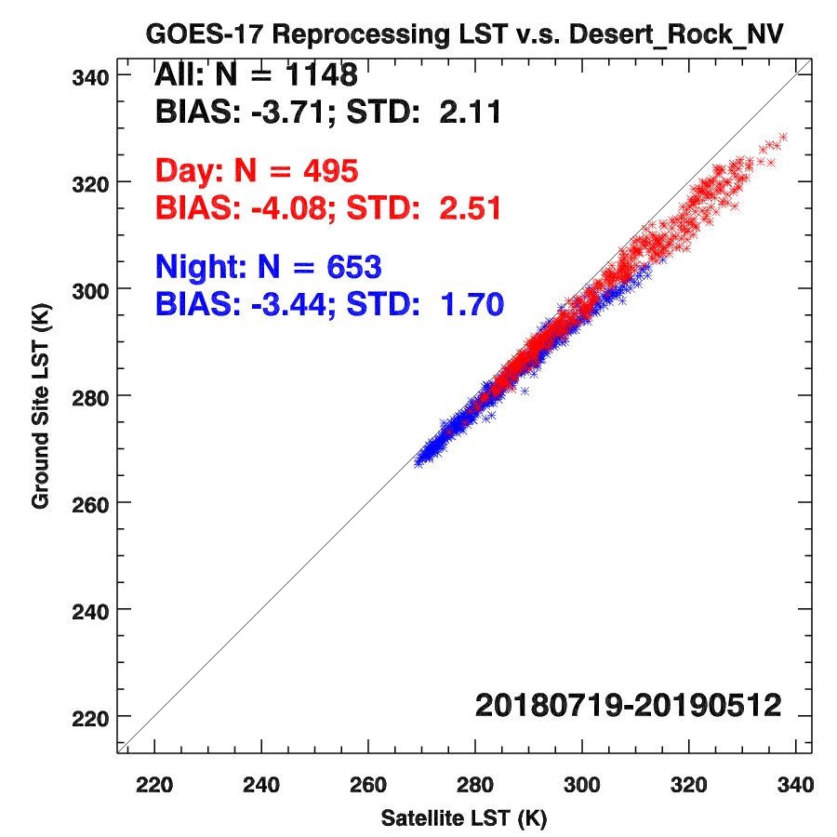
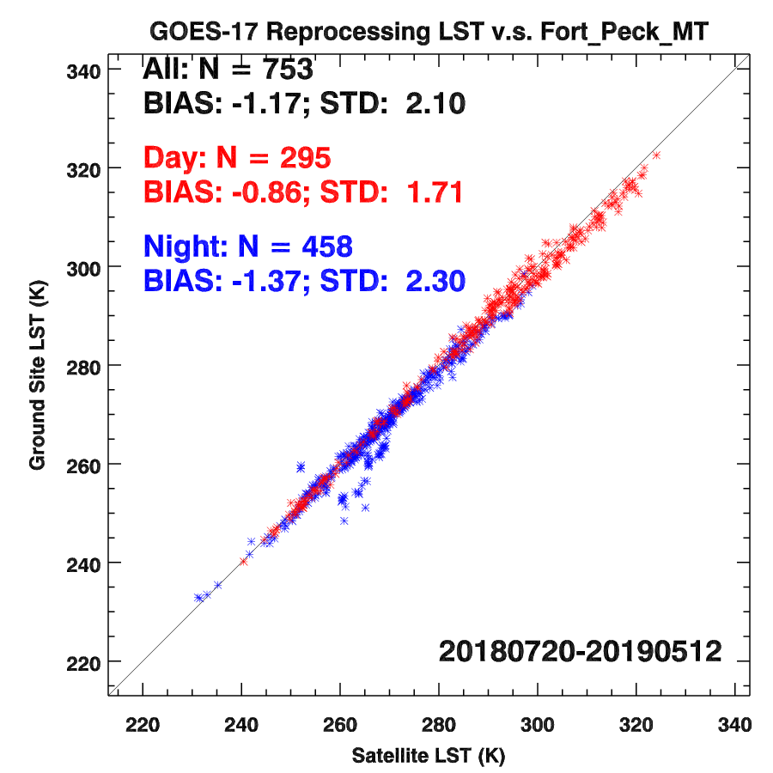
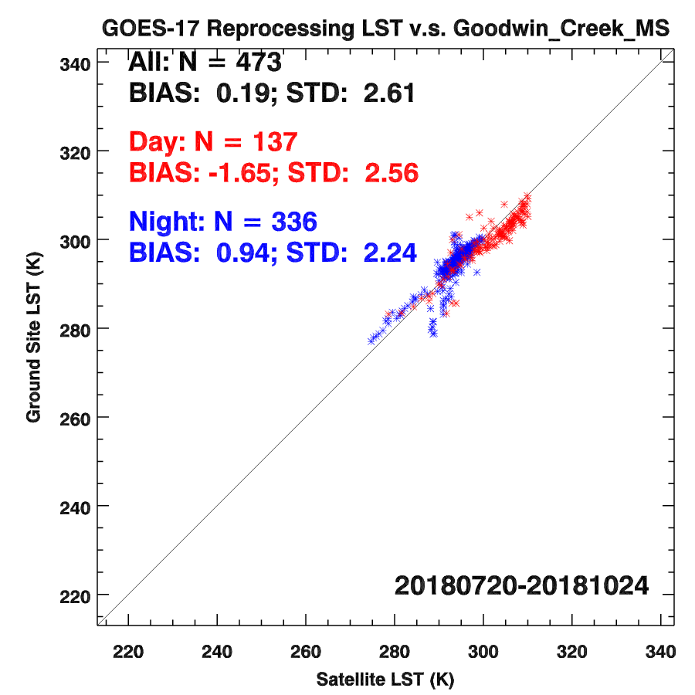
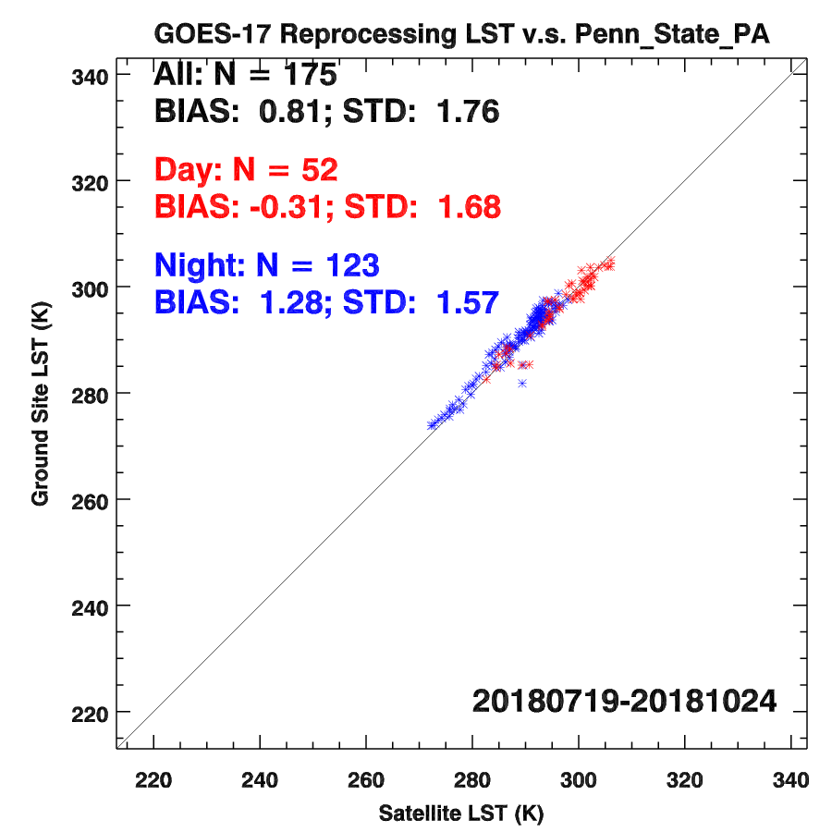
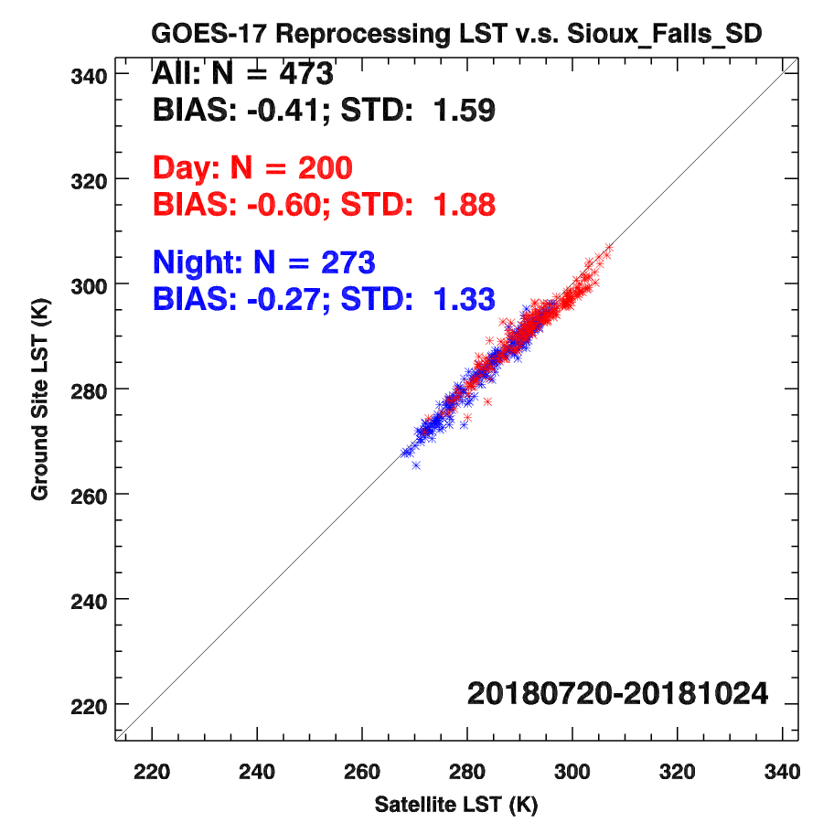
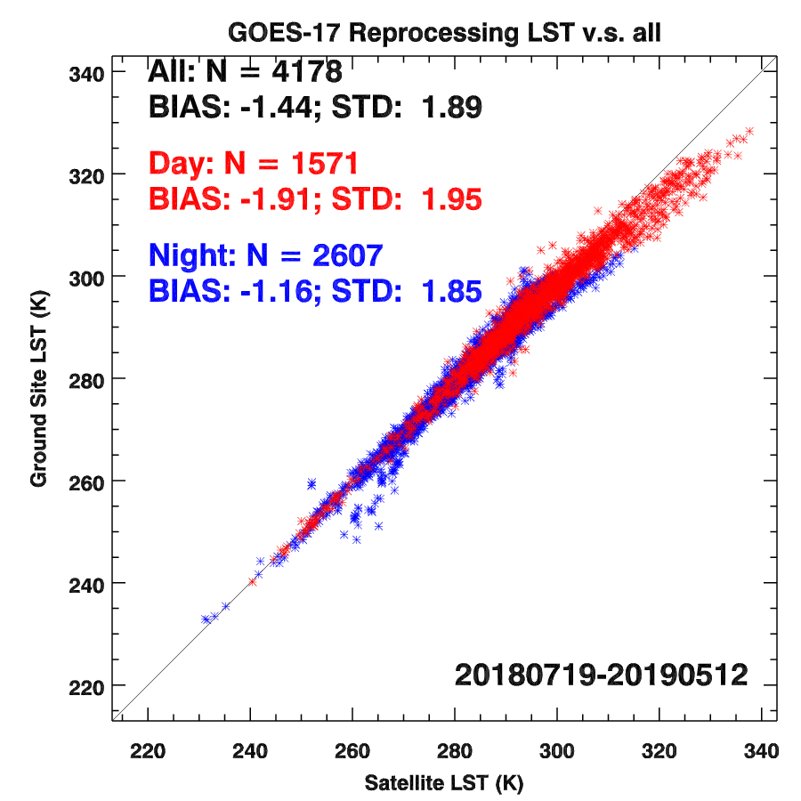
CONUS Validation (Reprocessed)
Notes:
Results based on reprocessed CONUS LST.
Validation results of Ground System and enterprise CONUS LSTs can be found in backup slides.
1.65 K underestimate during daytime at Goodwin Creek site, (analysis will be presented later)
Outliers can be seen, likely due to cloud contamination as shown in GOES-16 LST provisional presentation.

Slide 24
Full Disk LST Validation
(with TPW issue)
Site | Number | Accuracy (K) | Precision (K)
BND | 470 | -0.53 | 1.25
TBL | 357 | -0.71 | 1.73
DRA | 278 | -4.65 | 2.10
FPK | 326 | -0.48 | 2.21
GWN | 325 | -0.33 | 3.18
PSU | 76 | 0.60 | 1.55
SXF | 666 | 0.12 | 1.89
Overall | 2498 | -0.77 | 1.80
Notes:
Since aggregation procedure is not available to LST AWG, FD LST local calculation similar to CONUS LST can not be performed.
Serious underestimate at Desert Rock site and large standard deviation at Goodwin Creek site.
Overall results meet the mission requirement.

Slide 25
MESO LST Validation
Site | Number | Ground System |  | Reprocessed |  | Enterprise
 |  | Accuracy | Precision | Accuracy | Precision | Accuracy | Precision
BND | 24 | -0.58 | 2.70 | 0.14 | 2.69 | 0.95 | 2.79
TBL | 371 | -2.37 | 1.68 | -1.55 | 1.67 | -1.03 | 1.63
DRA | 738 | -4.67 | 1.98 | -3.56 | 2.15 | -2.39 | 2.18
FPK | 2 | -1.26 | 0.10 | -1.89 | 0.11 | -1.60 | 0.10
GWN | 43 | -0.09 | 3.35 | 0.96 | 3.43 | 1.96 | 3.37
PSU | 18 | -0.82 | 1.64 | 0.20 | 1.62 | 1.23 | 1.86
SXF | 0
Overall | 1196 | -3.64 | 1.91 | -2.64 | 2.01 | -1.69 | 2.03
Notes:
Validation results at most sites are good.
Data matchup with SURFRAD sites are limited, the statistics is less significant compared to CONUS and FD LST.
Significant underestimate at Desert Rock can be observed even though it is improved by fixing the TPW issue.
Precision is not good at Goodwin Creek site (More analysis will be presented).
Large bias of LST from GS due to: 1. TPW unit; 2. Desert Rock machup accounts almost 2/3 of the total matchup.
Overall statistics suggests the mission requirement has been marginally met (LST from reprocessed).
In general, the enterprise algorithm is superior to baseline algorithm and can meet the mission requirement.

Slide 26
GOES-17 LST vs. SURFRAD LST
Period : June 1, 2017 – March 5, 2018
Site | Specifications Met Products?
Domain | CONUS |  | Full Disk |  | MESO
Site | Accuracy | Precision | Accuracy | Precision | Accuracy | Precision
Bondville_IL | √ | √ | √ | √ | √ | √
Boulder_CO | √ | √ | √ | √ | √ | √
Desert_Rock_NV | × | √ | × | √ | × | √
Fort_Peck_MT | √ | √ | √ | √ | √ | √
Goodwin_Creek_MS | √ | √ | × | √ | √ | ×
Penn_State_PA | √ | √ | √ | × | √ | √
Sioux_Falls_SD | √ | √ | √ | √ | NA | NA
Overall | √ | √ | √ | √ | √ | √
Results for CONUS and MESO are based on if TPW unit issue gets fixed (ADR 970)
Notes:
Both CONUS and FD LSTs met the mission requirement.
Reprocessed MESO LST marginally meets the mission requirement. MESO LST from GS doesn’t meet the bias requirement.

Slide 27
Analysis at Desert Rock Site

Slide 28
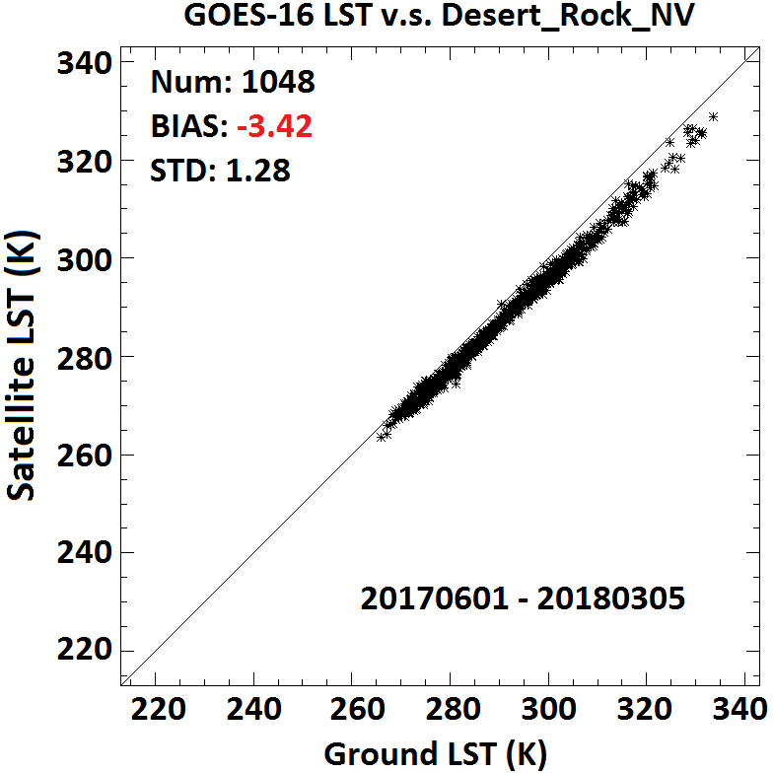
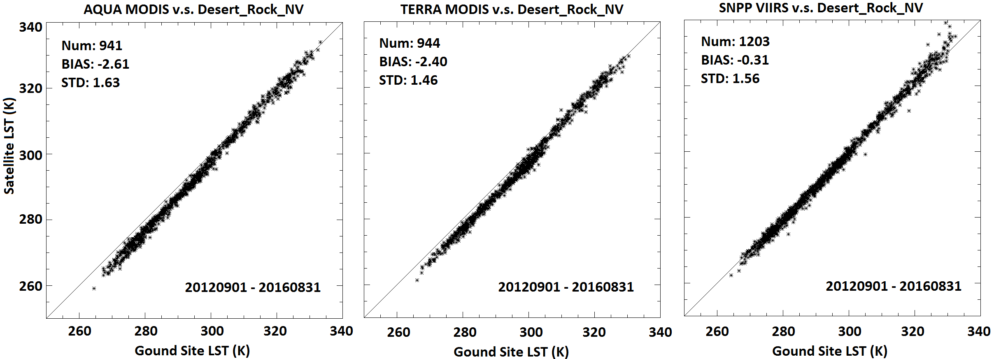
Desert Rock Validation Results
--Multiple satellites
Four years LST time series from AQUA, TERRA, and SNPP are compared to Desert Rock LST as a comparison
GOES-16 LST underestimate at Desert Rock site
SNPP VIIRS LST performs much better with an underestimate as low as 0.31 k
              Surface Type dependent algorithm, coefficient can be easily fine-tuned for any specific surface type
Notes:
Satellite LST retrieval at barren sites like Desert rock is challenging, usually with large underestimate. This is the case for GOES-16, AQUA, and TERRA.
The IDPS VIIRS LST performs good at this site, however, it is based on a surface-type dependent algorithm.

Slide 29
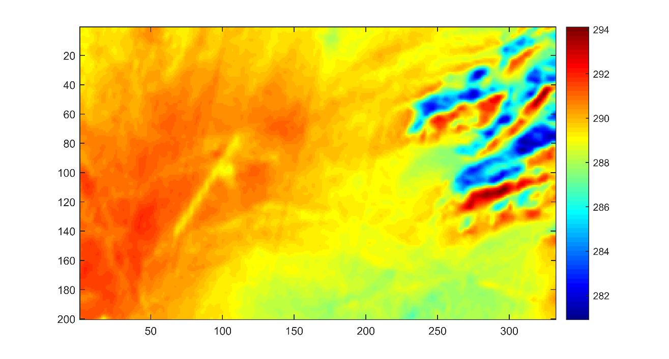
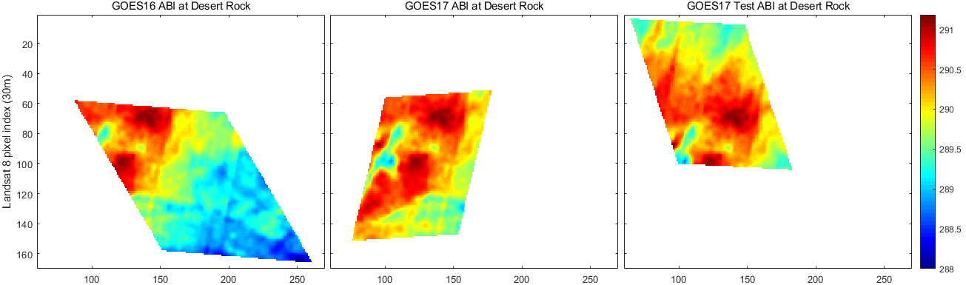
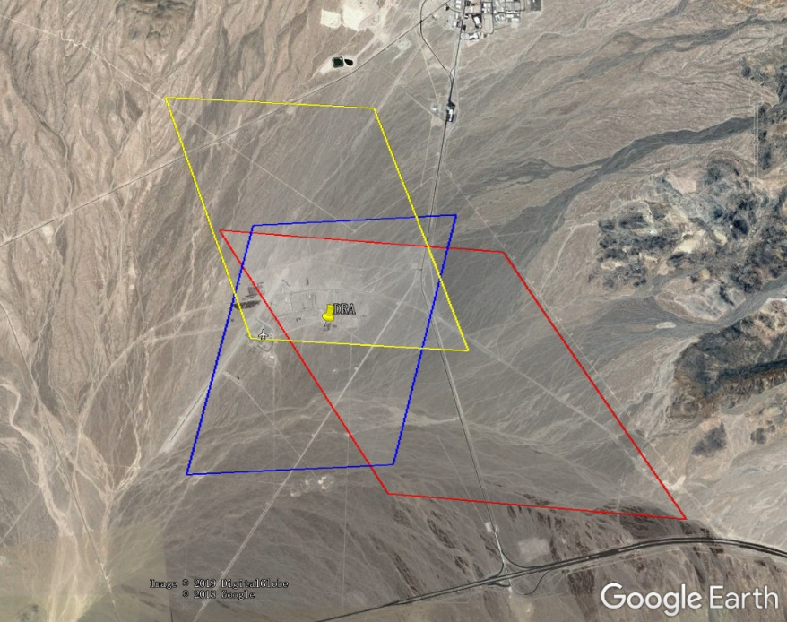
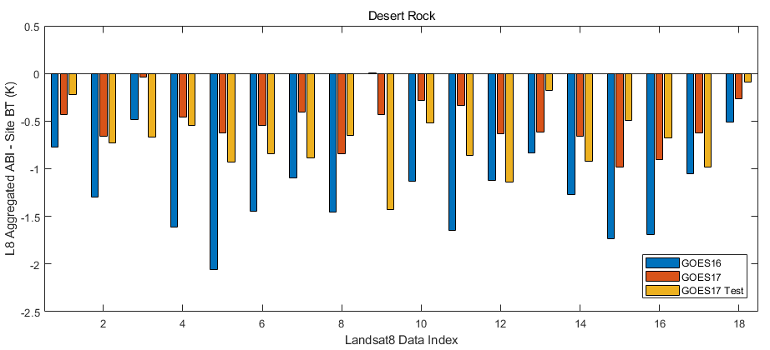
Representativeness of Desert Rock site
30m Landsat 8 BT11 (B10) at Desert Rock, 20180128
Desert Rock Landsat 8 BT11 Image
Left: GOES16; Center: GOES17ABI;Right: GOES17 Test
Aggregated ABI BT – Site L8 BT
G16 East (-1.18K); G17 West(-0.54K); G17 Test(-0.71K)
Desert Rock (Red: GOES16; Blue: GOES17; Yellow: GOES17 Test)
Notes:
Landsat observation (30 km x 30 km pixel) is used to investigate the heterogeneity at Desert Rock and Goodwin Creek.
Matchup with GOES-17 is limited, and only at daytime. Underestimates of ABI at West, Test, and East are observed. This partly explains the satellite LST underestimate.
Topography and land surfaces are complicated near Desert rock site, leading to strong heterogeneity. The 11 micron Landsat 8 band observation is highly consistent with the topography.
Note: The enterprise algorithm leads to similar bias to MODIS at this site regardless of the large pixel size.
Analysis assumes precise navigation data.
Due to its fixed grid, systematic bias can be more apparent in LSTs from geo-stationary satellites.
Further analysis is needed to improve the satellite LST retrieval at barren surface.

Slide 30
Analysis at Goodwin Creek Site

Slide 31
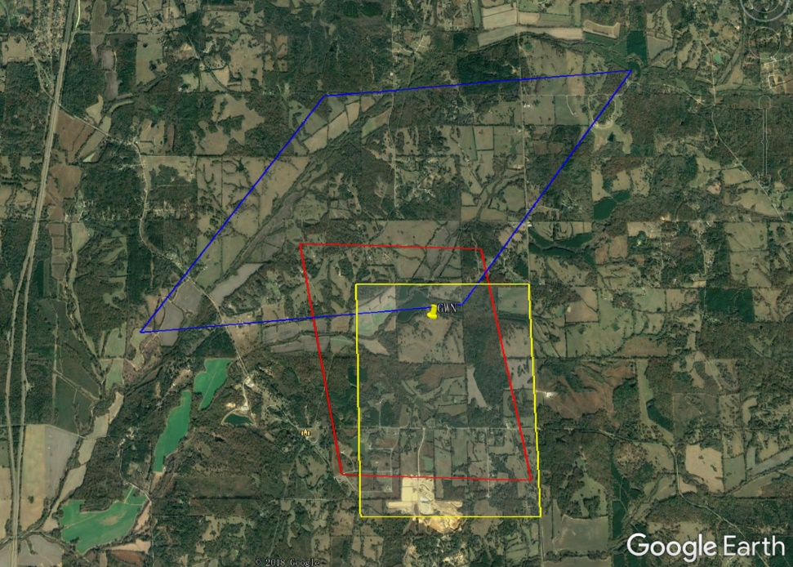
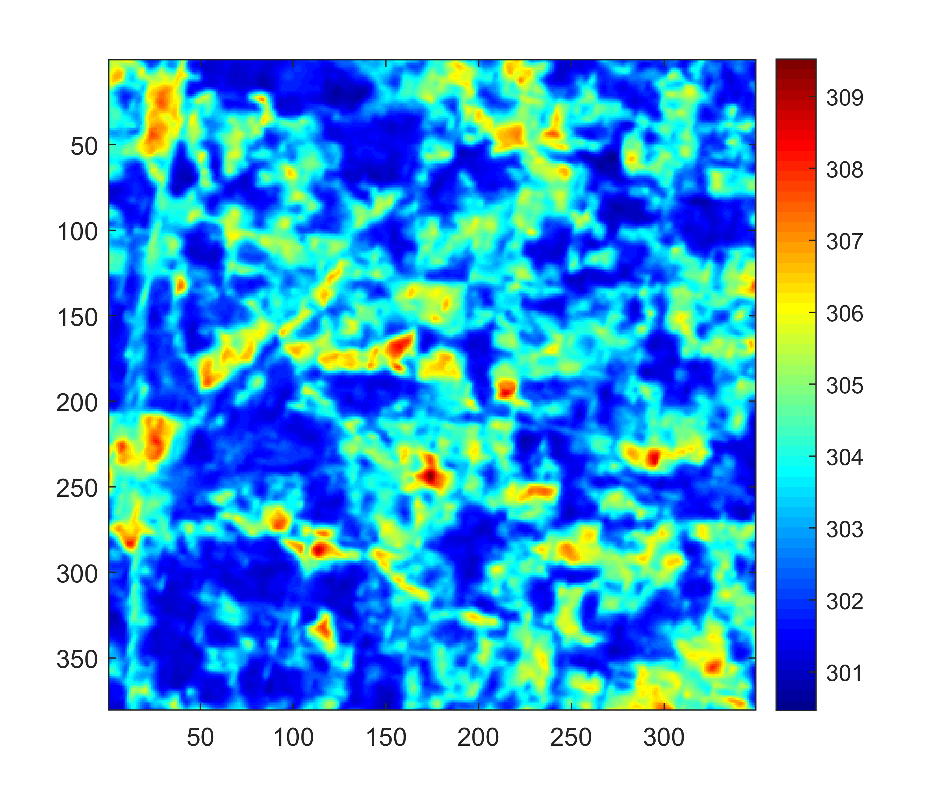
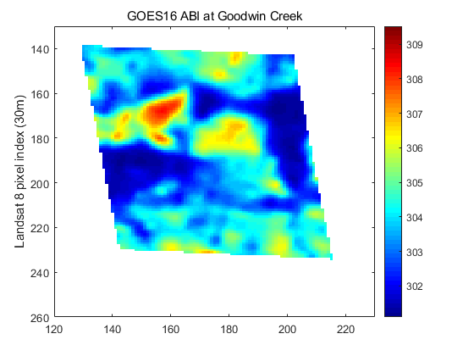
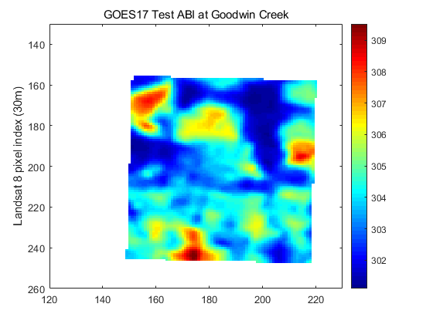
Goodwin Creek Site
Goodwin Creek (Red: G16 East; Blue: G17 West; Yellow: G17 Test)
Validation based on direct comparison with in-situ observation: pixel to point
Site representativeness of the satellite pixel is key: good homogeneity required
The complicated surface type shown on the right leads to high uncertainty when comparing the point temperature to pixel temperature
Full Disk LST has 10 km resolution at nadir, a homogeneous site in such a large area is not available in CONUS.
L8 BT11 at Goodwin Creek, 20180607
Goodwin Creek Landsat 8 BT11 Image
Left: GOES16 East; Right: GOES17 Test
Notes:
Large land surface variability is obvious nearby Goodwin Creek site → Large error standard deviation

Slide 32
Summary
The overall validation results indicate satisfactory performance for baseline product during “cool” period
Validation results vary among different sites.
Satellite LST is significantly lower than its in-situ counterpart at Desert Rock site
Standard deviation at Goodwin Creek site is high
Site homogeneity is crucial in LST validation
Notes:
Performance of enterprise algorithm is better than baseline.

Slide 33
Comparison with LSTs from Other Sensors

Slide 34
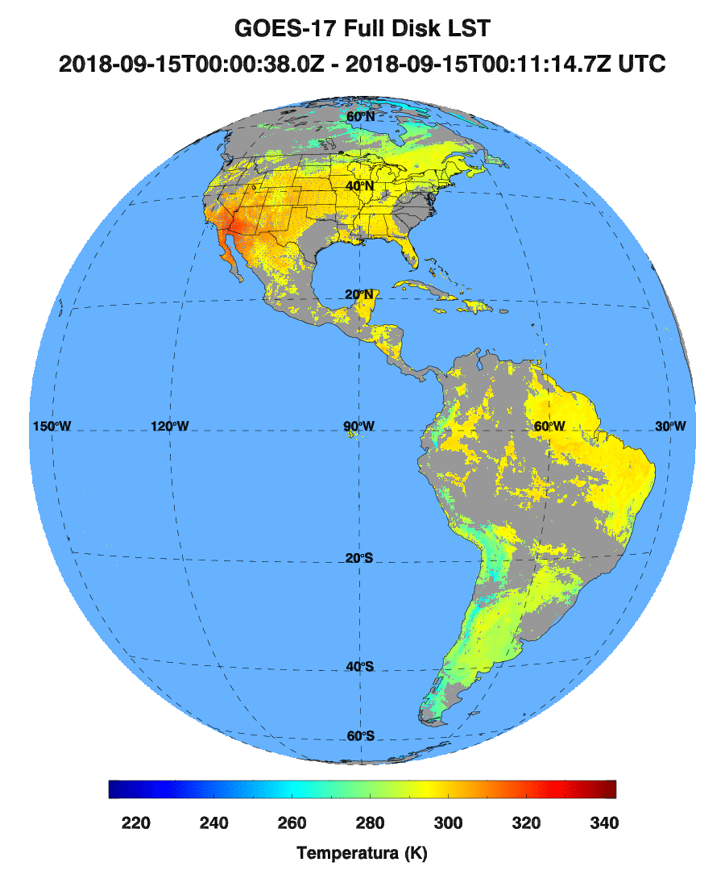
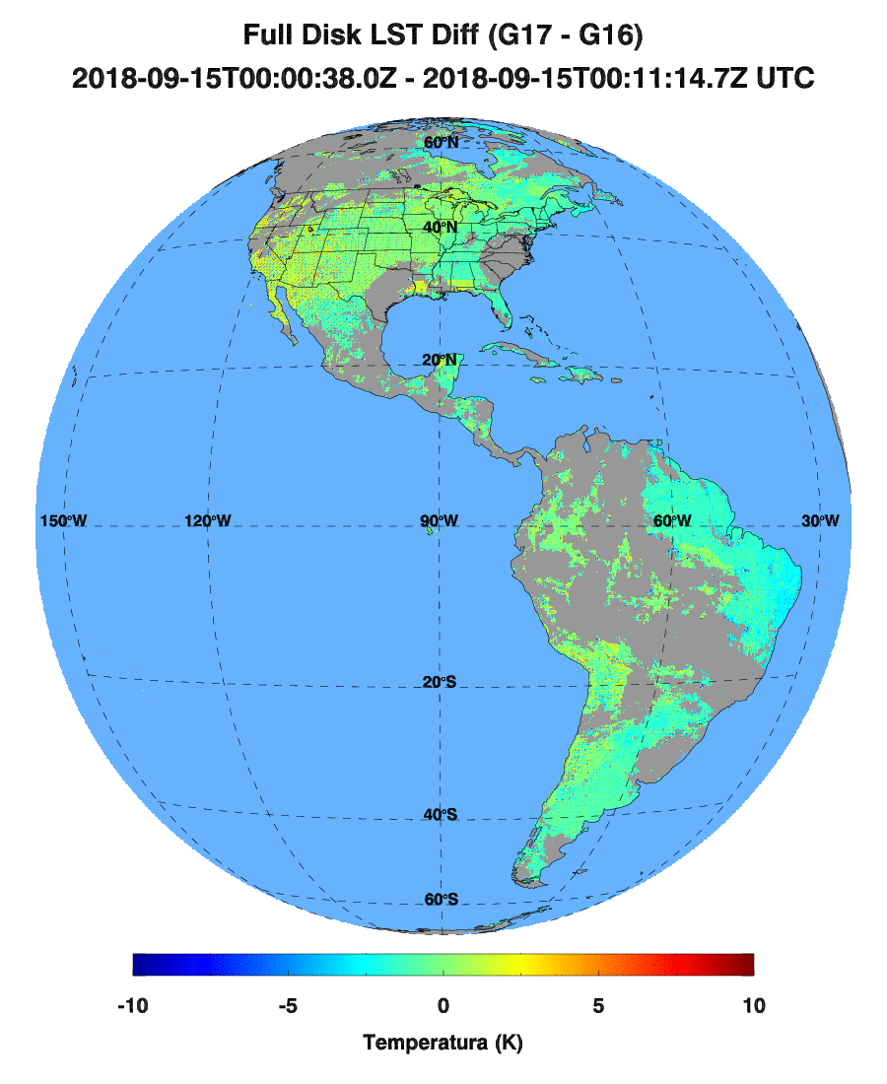
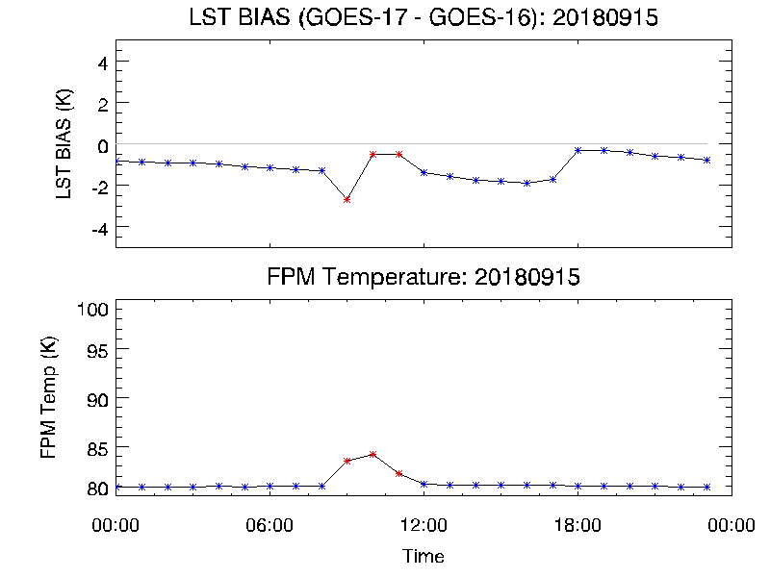
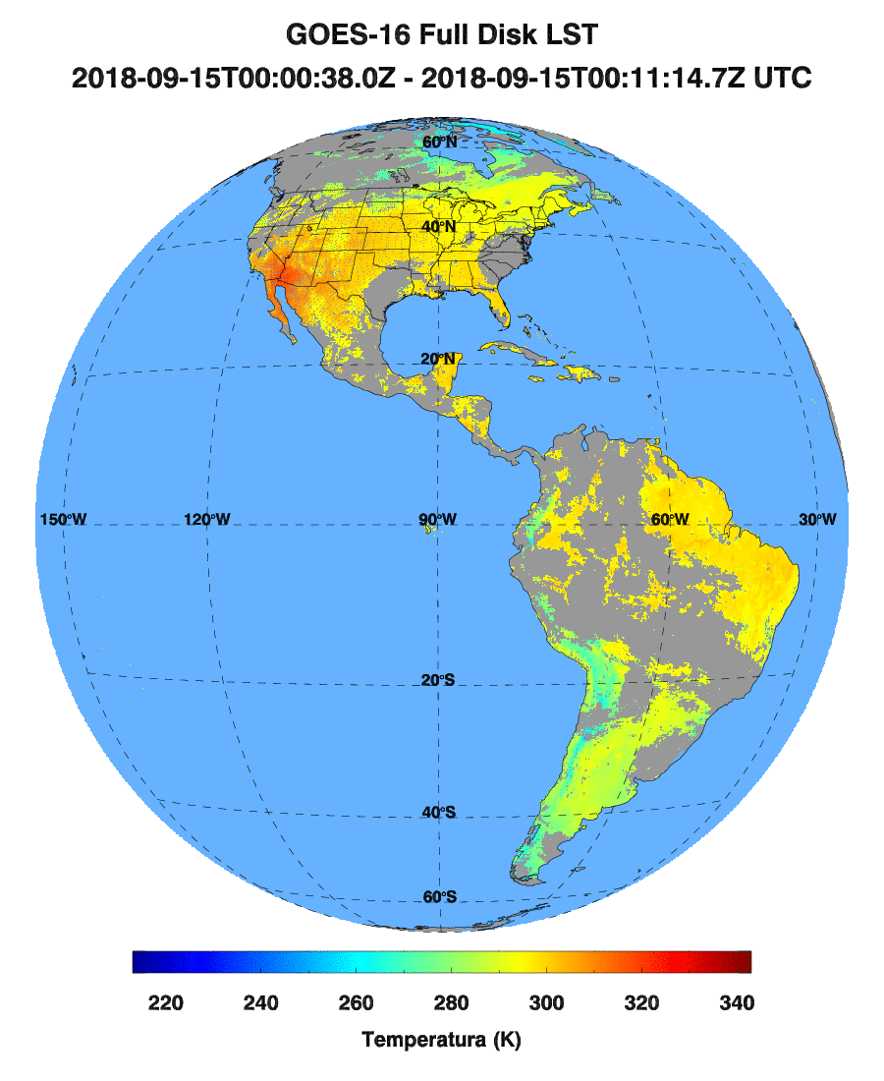
FD LST Comparison (G17 v.s. G16)
2019-09-15
GOES-16 FD LST projected to GOES-17 (Test) FD grid
Observation time difference between two sensors are within 5 minutes.
FPM temperature is relatively low with the maximum at around 85 K
Red dots indicate when FPM temperature is higher than 82 K
The bias is acceptable.
Notes:
The impact of FPM temperature on retrieval bias is not significant in this case.

Slide 35
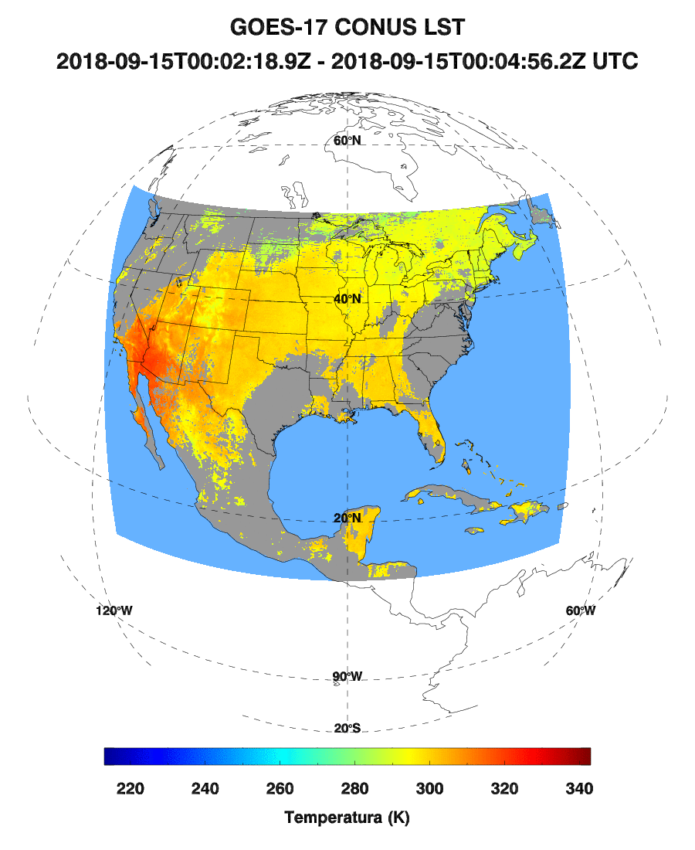
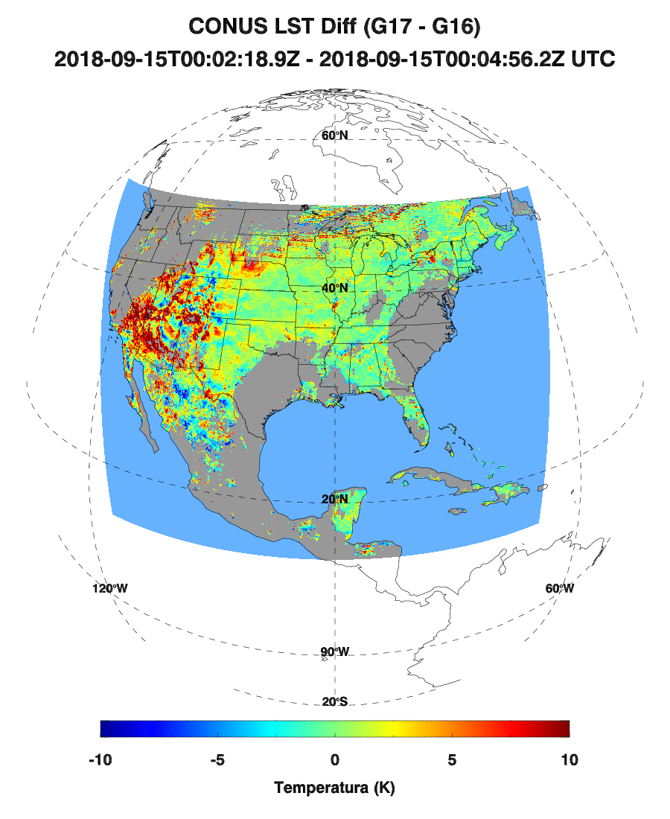
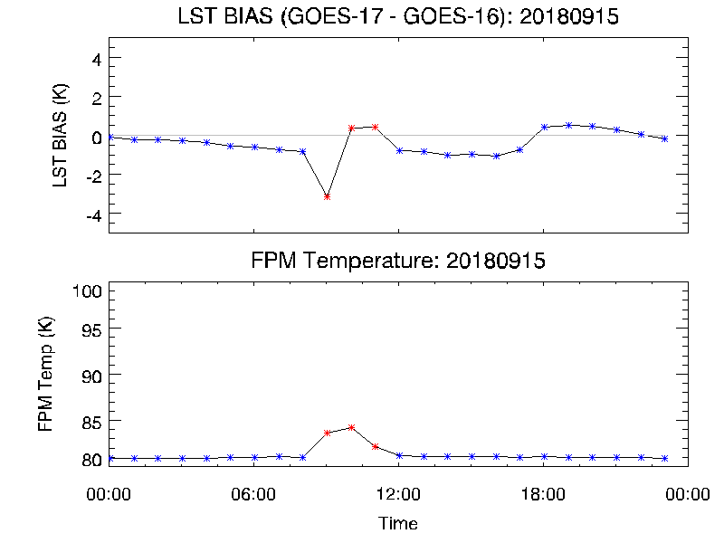

CONUS LST Comparison (G17 v.s. G16)
2019-09-15
GOES-16 CONUS LST projected to GOES-17 (Test) CONUS grid
Observation time difference between two sensors are within 5 minutes.
FPM temperature is relatively low with the maximum at around 85 K
Red dots indicate when FPM temperature is higher than 82 K
The bias at 23 hours are good.
At hour 9 (with around 85 K FPM temperature) GOES-17 LST is 3 K lower than GOES-16 LST

Slide 36
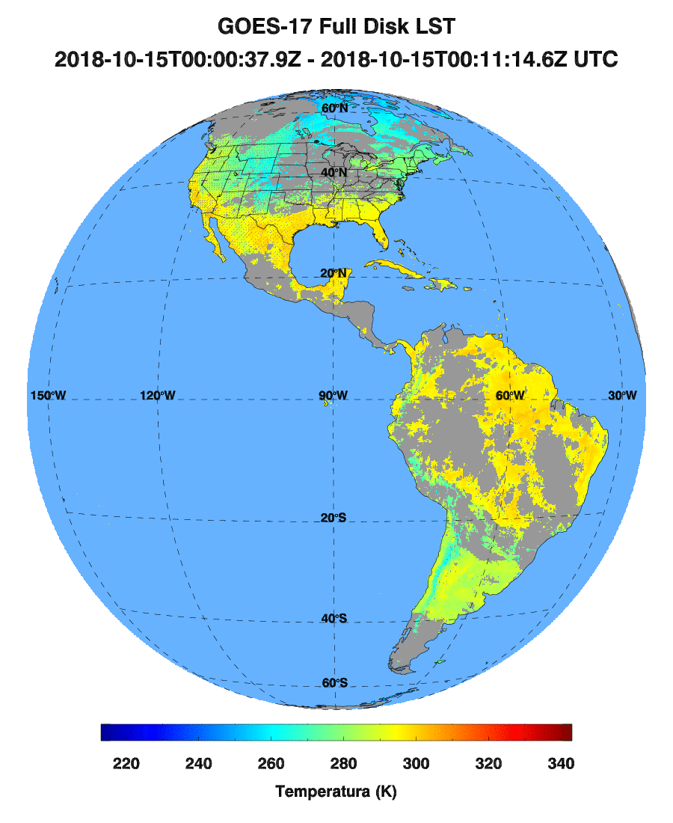
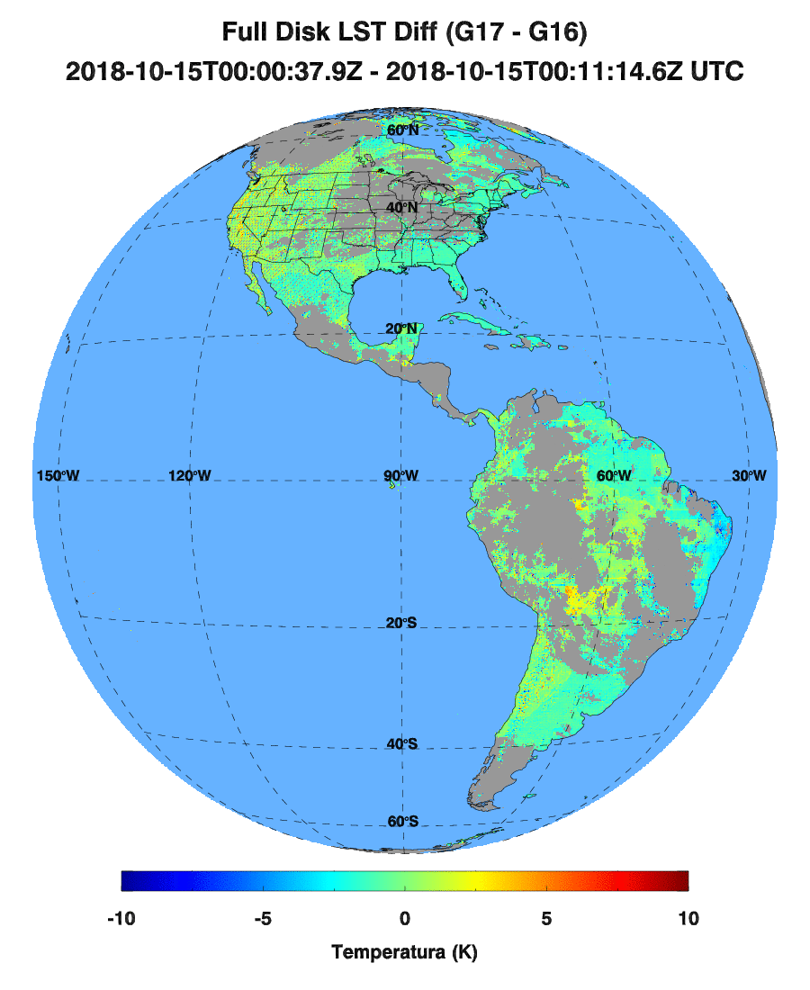
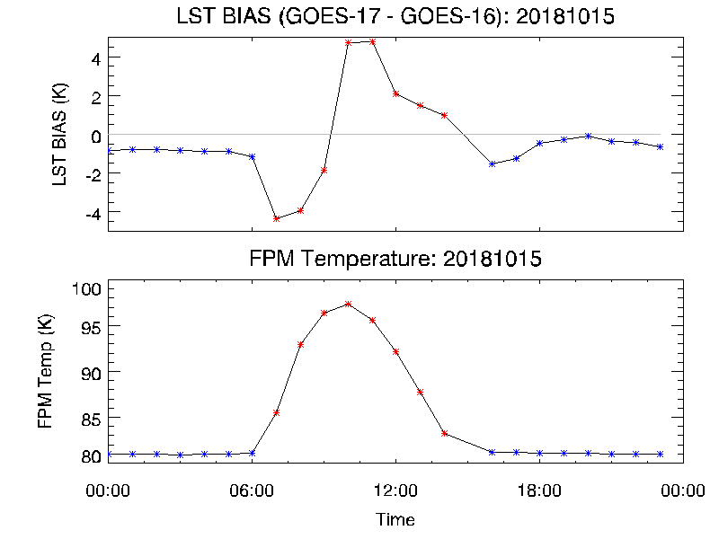

FD LST Comparison (G17 v.s. G16)
2019-10-15
GOES-16 FD LST projected to GOES-17 (Test) FD grid
Observation time difference between two sensors are within 5 minutes.
FPM temperature is high with the maximum at around 98 K
Red dots indicate when FPM temperature is higher than 82 K
Bias is large during “hot” period.
Comparison at mountain areas are worse.
Notes:
At its peak time during a year, the FPM temp can reach higher than 100 K, much worse than shown here.

Slide 37
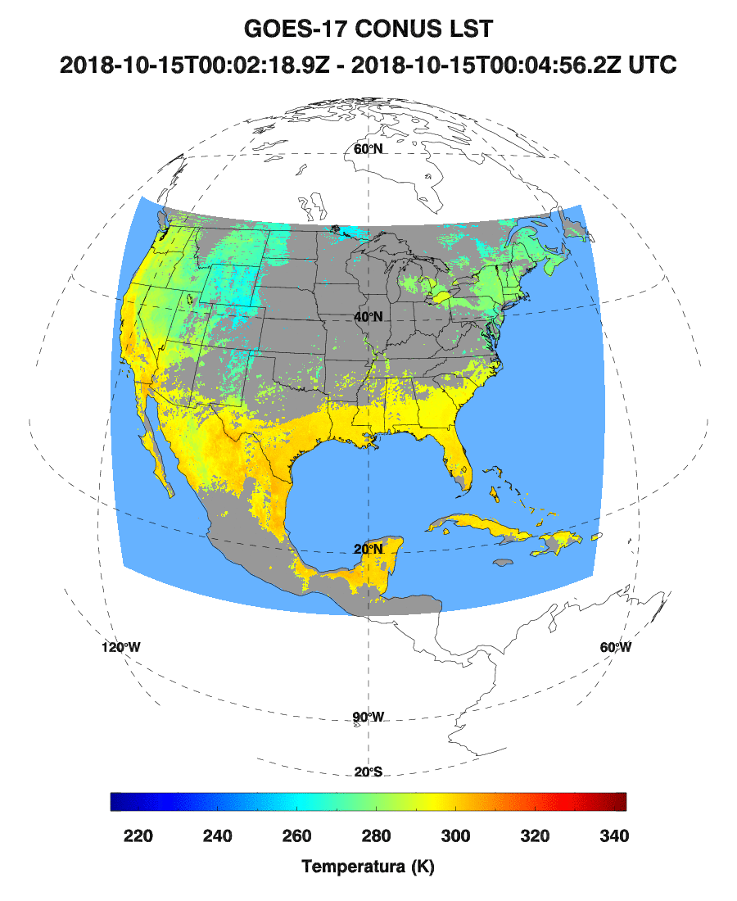
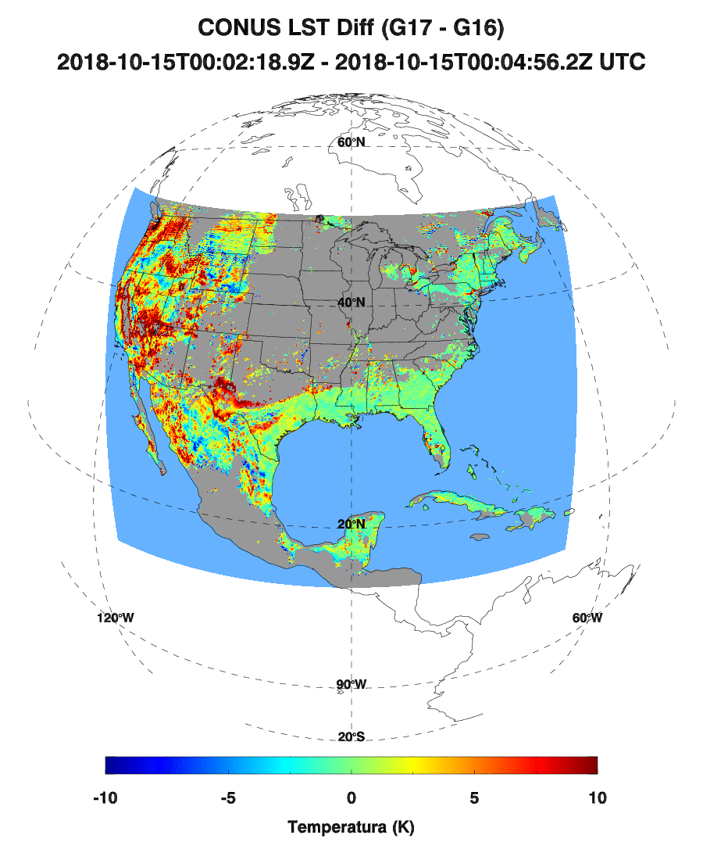
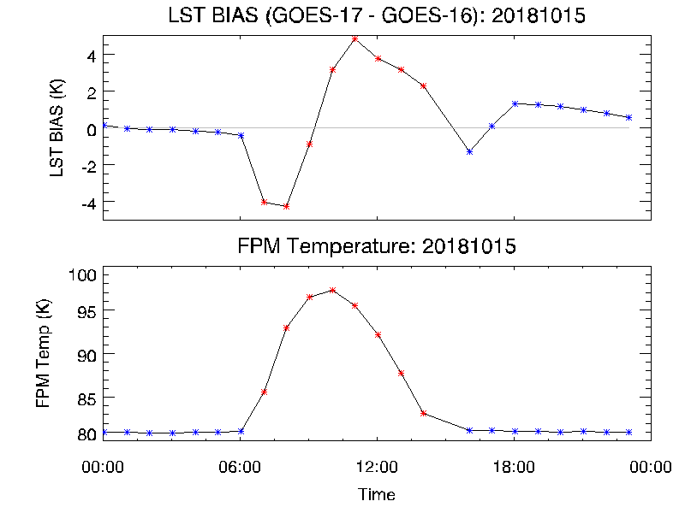
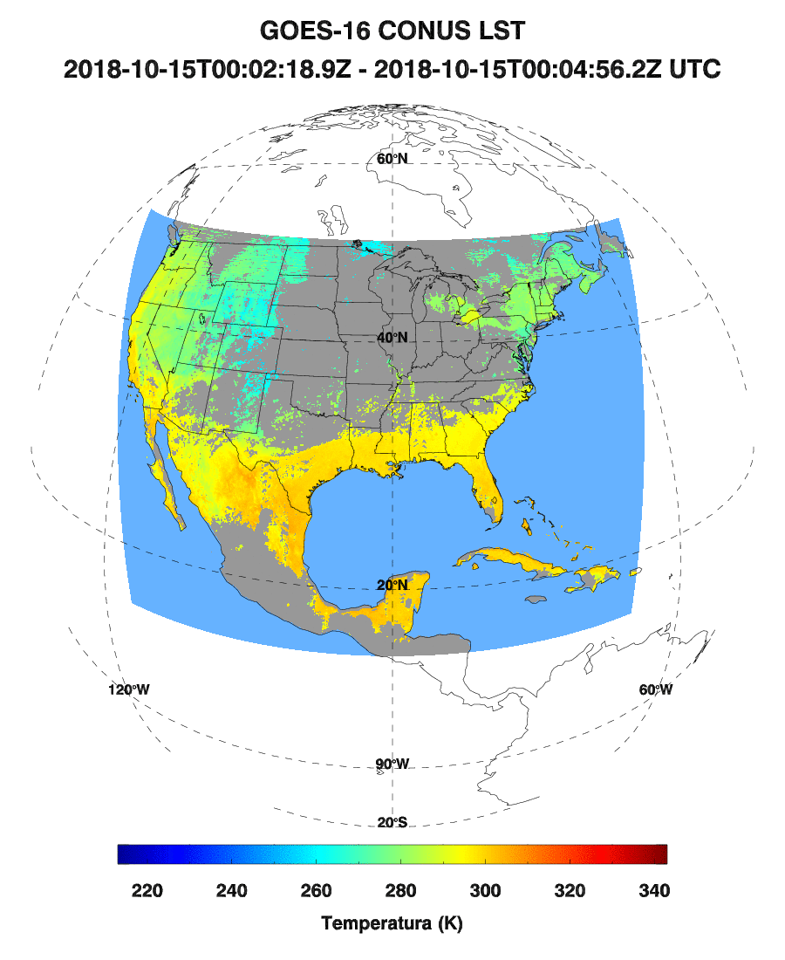
CONUS LST Comparison (G17 v.s. G16)
2019-10-15
GOES-16 CONUS LST projected to GOES-17 (Test) CONUS grid
Observation time difference between two sensors are within 5 minutes.
FPM temperature is high with the maximum at around 98 K
Red dots indicate when FPM temperature is higher than 82 K
Bias is large during “hot” period.
Comparison at mountain areas are worse.

Slide 38
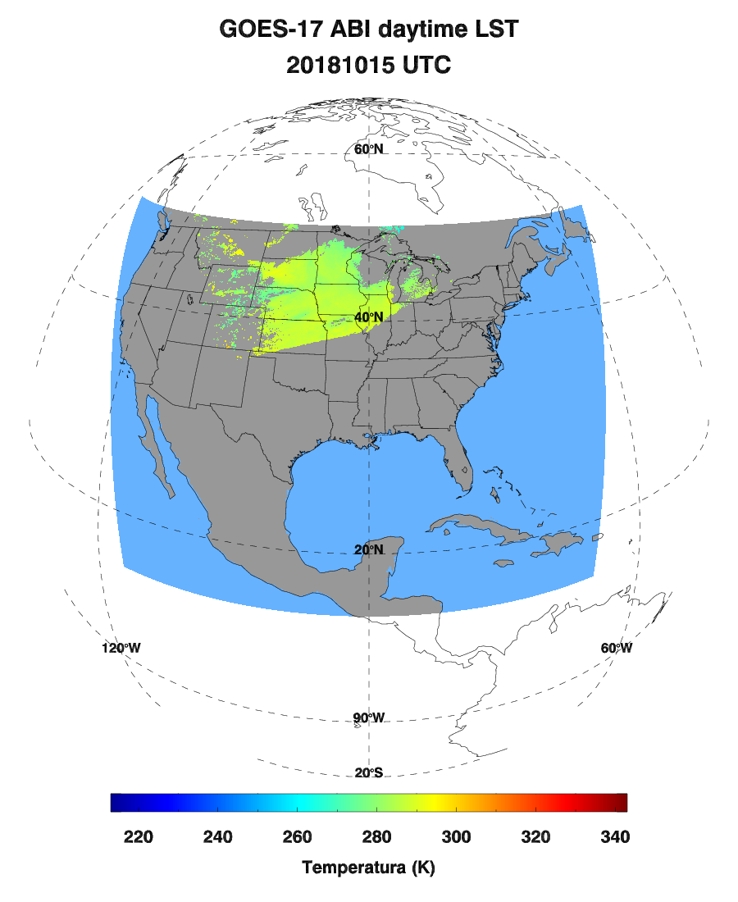
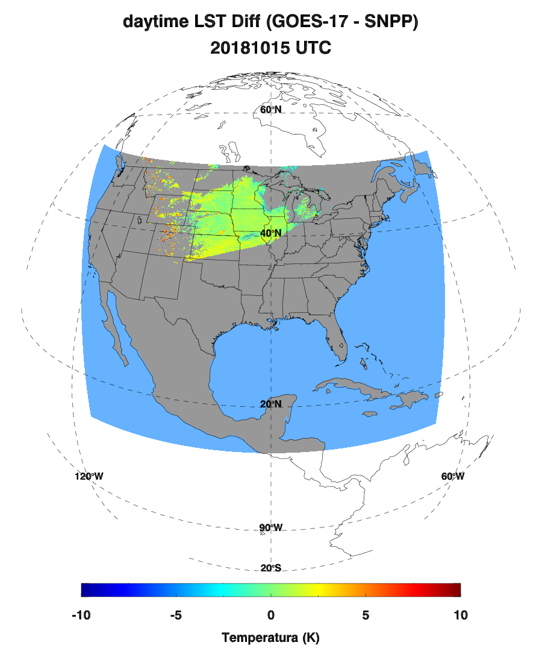
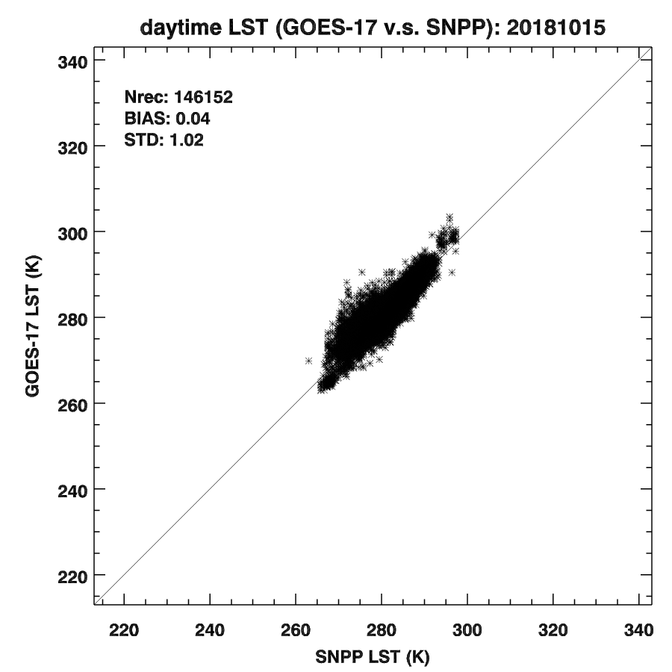
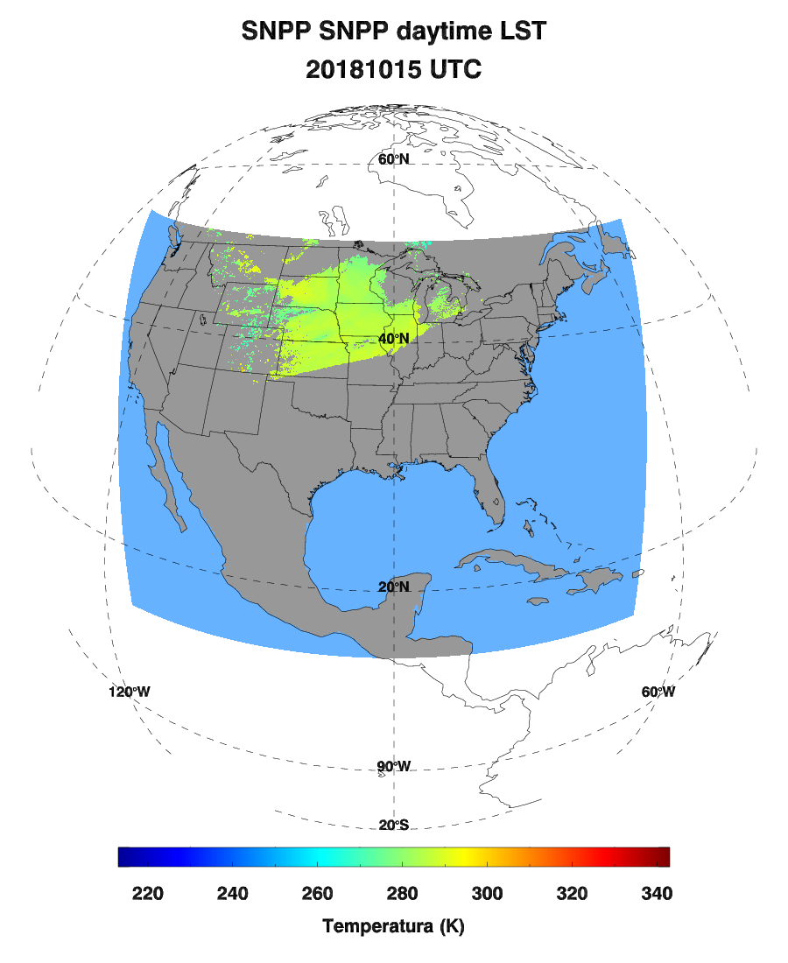
CONUS LST v.s. SNPP
20181015 (Daytime)
VIIRS LST aggregated to GOES-17 CONUS grid
VIIRS LST is confidently clear
Observation time difference between two sensors are within 5 minutes.
Notes:
SNPP is afternoon orbit

Slide 39




CONUS LST v.s. SNPP
20180915 (Nighttime)
VIIRS LST aggregated to GOES-17 CONUS grid
VIIRS LST is confidently clear
Observation time difference between two sensors are within 5 minutes.
VIIRS LST matched to GOES-17 during nighttime with low and stable FPM temperature is extremely limited.
Notes:
The nighttime retrieval is less impacted by the solar angles and the surface heterogeneity. When retrieval is not significantly impacted by the FPM temperature, it is highly consistent with the polar-orbit LST retrieval

Slide 40




CONUS LST v.s. SNPP
20190315 (Daytime)
VIIRS LST aggregated to GOES-17 CONUS grid
VIIRS LST is confidently clear
Observation time difference between two sensors are within 5 minutes.
Notes:
The comparison at mountain areas is likely impacted by the surface elevation, the slope, and surface emissivity.

Slide 41




CONUS LST v.s. NOAA-20
20181015 (Daytime)
VIIRS LST aggregated to GOES-17 CONUS grid
VIIRS LST is confidently clear
Observation time difference between two sensors are within 5 minutes.
Notes:
An example of comparison with NOAA-20 (also afternoon orbit)
More examples can be found in the backup slides.

Slide 42




CONUS LST v.s. AQUA
20181015 (Daytime)
MODIS LST aggregated to GOES-17 CONUS grid
MODIS LST with cloud flag as 0
Observation time difference between two sensors are within 5 minutes.
Notes:
AQUA afternoon orbit
The results are similar to SNPP. More in backup.

Slide 43




CONUS LST v.s. TERRA
20190315 (Nighttime)
MODIS LST aggregated to GOES-17 CONUS grid
MODIS LST with cloud flag as 0
Observation time difference between two sensors are within 5 minutes.
Notes:
TERRA: morning orbit.
More from backup slides.

Slide 44




CONUS LST v.s. TERRA
20190315 (Daytime)
MODIS LST aggregated to GOES-17 CONUS grid
MODIS LST with cloud flag as 0
Observation time difference between two sensors are within 5 minutes.

Slide 45
Provisional Maturity Assessment
GOES-17 Land Surface Temperature L2 Product Provisional PS-PVR

Slide 46
Provisional Validation
Preparation Activities | Assessment
Validation activities are ongoing and the general research community is now encouraged to participate. | Validation activities are ongoing. The user community has been participating.
Severe algorithm anomalies are identified and under analysis. Solutions to anomalies are in development and testing. | Operational and algorithm anomalies have been identified. Critical ones have been resolved; only one LST ADR remains to be implemented.
Incremental product improvements may still be occurring. | Incremental product improvements are expected.
Notes:
This needs update from the management?

Slide 47
Provisional Validation
End State | Assessment
Product performance has been demonstrated through analysis of a small number of independent measurements obtained from select locations, periods, and associated ground truth or field campaign efforts. | This has been demonstrated.
Product analysis is sufficient to communicate product performance to users relative to expectations (Performance Baseline). | This has been communicated in PS-PVR.
Documentation of product performance exists that includes recommended remediation strategies for all anomalies and weaknesses. Any algorithm changes associated with severe anomalies have been documented, implemented, tested, and shared with the user community. | These are documented in this slide and will be documented in a separate report.
Testing has been fully documented. | Testing will be documented in a PLPT Report.
Product is ready for operational use and for use in comprehensive cal/val activities and product optimization (only applies to times when the focal plane module temperature is at or near the nominal value). | Agree
Notes:
This needs update from management?

Slide 48
Recommendation
AWG LST Team believes that the GOES-17 LST L2 product during “cool” period has reached the Provisional Maturity as defined by the GOES-R Program

Slide 49
Path to DELTA REVIEW
GOES-17 Land Surface Temperature L2 Product Provisional PS-PVR

Slide 50
Issues
Major issues:
  FPM overheating degrades product quality
  The unit of TPW for LST retrieval used in ground system is likely incorrect
  Significant underestimate at Desert Rock site
Others:
  PQI included in IP provides detailed information about LST retrieval, but is not accessible by users
  Full Disk LST resolution of 10 km is significantly larger than the SURFRAD in-situ footprint (~ a few tens meters) and limits its application
  Existing hourly LST output requirement limits its application
  Emissivity used in operational LST retrieval is from year 2005 Seebor emissivity monthly climatology and can not reflect the real-time land surface variation

Slide 51
Path to Delta Maturity
Analysis of potential band replacement by those less impacted by LHP overheating
Improve and deliver the enterprise algorithm
  Underestimate at Desert Rock site is expected to be dramatically reduced.
The incorrect unit of TPW used in LST retrieval needs to be fixed
We expect to carry out the same activities for Delta maturity review
  The collection of subset data will continue. The current LST time series is not long enough to yield statistically significant conclusions.
  Case studies will be carried out.
  Comparison with polar orbit satellite LST will continue
Currently outstanding issues, unless fixed by handover, may prevent declaration of Operational Maturity
  An optimal characterization of “hot” period, when product is seriously degraded is needed.

Slide 52
Full Validation PLPTs
PLPT ID | Descriptive Title
ABI-FD_LST12 | FD product accuracy and precision assessment
ABI-CONUS_LST13 | CONUS product accuracy and precision assessment
ABI-MESO_LST14 | MESO product accuracy and precision assessment
AWG LST Team will conduct these tests to further evaluate the L2 LST product quality.
Full test plans and procedures are given in the LST Readiness, Implementation, and Management Plan (RIMP v1.0; 416-R-RIMP-0331)

Slide 53
Path to Delta Validation – Risks
Risk Name | Description | Impact | Mitigation and Schedule
Operation Stability | IF corrections for known anomalies cannot be implemented timely | THEN the operation will not reach steady state for evaluation | Raise awareness Work with Ground

Slide 54
Summary & Recommendations
GOES-17 Land Surface Temperature L2 Product Provisional PS-PVR

Slide 55
Summary
The analysis is based on the data with relatively low and stable FPM temperature
Overall, all three LST products during “cool” period meet the mission requirement of accuracy and precision.
  Validation results vary among different ground stations.
  Mission requirement is not met at some stations.
The LST product performance will be improved if TPW issue is fixed.
Enterprise LST outperforms baseline LST.
Notes:
Definition of “cool” period is given at www.goes-r.gov

Slide 56
Recommendation
AWG Land Surface Temperature Team believes that the GOES-17 LST L2 product during “cool” period has reached the Provisional Maturity as defined by the GOES-R Program

Slide 57
Backup SLIDES
GOES-17 Land Surface Temperature L2 Product Provisional PS-PVR

Slide 58
Risks to Reaching Provisional
Risk | Description | Impact | Mitigation | Current Status
Focal Plan Module (FPM) overheating | Due to FPM overheating issue, degradation of L1b data and the upstreaming EDR data as LST algorithm input was expected. This leads to the degradation of LST product especially during the nighttime. The impact is more significant between hours 06 and 15 UTC. | Major | LST team evaluates the product with relatively low impact from the issue, by removing high and unstable FPM temperature periods. The team is also working on a mitigation algorithm towards the Delta maturity. | The periods with high and unstable FPM temperature were removed for evaluation of the product performance. A mitigation algorithm is being worked on.
Navigation / Registration | Errors in sensor navigation/registration might degrade the LST data performance, though the band to band co-registration issue has been greatly reduced since L1b data beta maturity. | Unknown | LST team is actively monitoring the issue. | The issue was reported to be fixed on Sept. 13, 2018. No obvious navigation issues have been found.
outdated Emissivity used | Seebor emissivity monthly average at year 2005 used in LST retrieval might not be tuned to ABI sensor and can not reflect the real-time variation of the land surface. | Intermediate | LST AWG has developed the split-window channel emissivity for ABI sensor. | LST AWG developed the emissivity product for ABI sensor. Implementation in operational LST retrieval is not scheduled yet.
FD LST aggregation impact | Pixel size of FD LST is 10 km and has large mismatch with the SURFRAD in-situ (~ a few tens meters) | Unknown | TBD | Validation results with in-situ observations is acceptable. Site characterization is being studied.
Notes:
TPW is an important variable to determine which coefficient set is being used for specific pixel. The ground system incorrectly used TPW in mm instead of cm, which leads to significant bias in the LST product. The LST AWG team reported the issue on 6/23/2017 and it got fixed in OE since 1/25/2018 16:00 (UTC).
Emissivity used in LST retrieval is Seebor emissivity (monthly from year 2005), which is not tuned up for real-time operational LST retrieval and can not reflect the real-time variation of the land surface. The LST AWG team has developed its own daily emissivity product specific for ABI sensor.

Slide 59


Application: Drought
Notes:
Large negative RCI values in the top row indicate that moisture stress was rapidly increasing at the beginning of summer
Impressive scope of the unusually rapid decrease in the ESI anomalies is clearly depicted by the large area of negative RCI values
Initial appearance of negative RCI values led the introduction of severe drought in the USDM by more than 4 weeks

Slide 60

Application: Soil Moisture Downscaling

Slide 61
Quality Flag Inspection
Bit | Flag | Source | Effect
2-3 | Availability | SDR | 00=normal, 01=out of space, 10=bad data, 11=missing data
6-7 | Cloud Index | Cloud Mask | 00=clear, 01=probably clear, 10=probably cloudy, 11=cloudy
4-5 | Surface Type | Land/sea Mask | 00=land, 01=snow/ice, 10=in-land water, 11=sea
12-13 | LST Quality | LST | 00=normal, 01=cold surface (<250 K & >=213K), 10= out of range (not in 213-330K)
LST PQI
Bit | Flag | Source | Effect
1 | Availability | SDR | 0=normal, 1=out of space, bad data, missing data
2 | Cloud Index | Cloud Mask | 0=clear or probably clear, 1=probably cloudy, or cloudy
4 | Surface type | Land/sea mask | 0 = land, including inland water, 1= water
5 | LST Quality | LST | 0=normal, 1= out of range (not in 213-330K)
LST DQF
Notes:
The purpose of this inspection is to check if the LST values, DQF, and PQI are consistent with each other.

Slide 62
Definition of Error Codes
Availability
Surface Type
101: DQF = 0 but PQI = 1
102: DQF = 0 but PQI = 2 should be 0
103: DQF = 0 but PQI = 3
104: DQF = 1 but PQI = 0 should be 1
111*: DQF = 1 and PQI = 1, 2, or 3 but LST retrieved should be no retrieval
301*: DQF = 0 but PQI = 3 should be 0,1, or 2
302: DQF = 1 but PQI = 0
303: DQF = 1 but PQI = 1
304: DQF = 1 but PQI = 2
311: DQF = 1 and PQI = 3 but LST retrieved
Should be 3
Cloud Index
LST Quality
201: DQF = 0 but PQI = 2
202: DQF = 0 but PQI = 3
203: DQF = 1 but PQI = 0
204: DQF = 1 but PQI = 1
211: DQF = 1 and PQI = 2 or 3 but LST retrieved
401: DQF = 0 but PQI = 2 should be 0 or 1
402: DQF = 1 but PQI = 0
403: DQF = 1 but PQI = 1
404*: PQI = 3 Should be 0,1,or 2
411: 250.<=LST<=330. but PQI<>0
412: invalid LST but DQF(availability)=0 and DQF(surface type)=0 and DQF(cloud)=0 and PQI (quality)<>2
413: 213.<=LST<250. but PQI<>1
414: (LST<213. or LST>330.) but PQI<>2
Should be 0 or 1
Should be 2
Should be 2 or 3
*NA to FD LST
Notes:
Definition of error codes based on the metrics defined in previous slide.

Slide 63

High FPM Temperature Period
https://www.goes-r.gov/users/GOES-17-ABI-Performance.html
Notes:
The predicted “hot” periods in year 2019 listed in the table are removed for provisional activities.
We extended the table to when the satellite is on Test position by decreasing the start and end time of each period with 3 hours.

Slide 64








CONUS Validation (GS)

Slide 65








CONUS Validation (Enterprise)

Slide 66




CONUS LST v.s. NOAA-20
20180915 (Nighttime)

Slide 67




CONUS LST v.s. NOAA-20
20190315 (Daytime)

Slide 68




CONUS LST v.s. AQUA
20180915 (Nighttime)

Slide 69




CONUS LST v.s. TERRA
20181015 (Daytime)

Slide 70




CONUS LST v.s. TERRA
20180915 (Nighttime)

